Slide 1
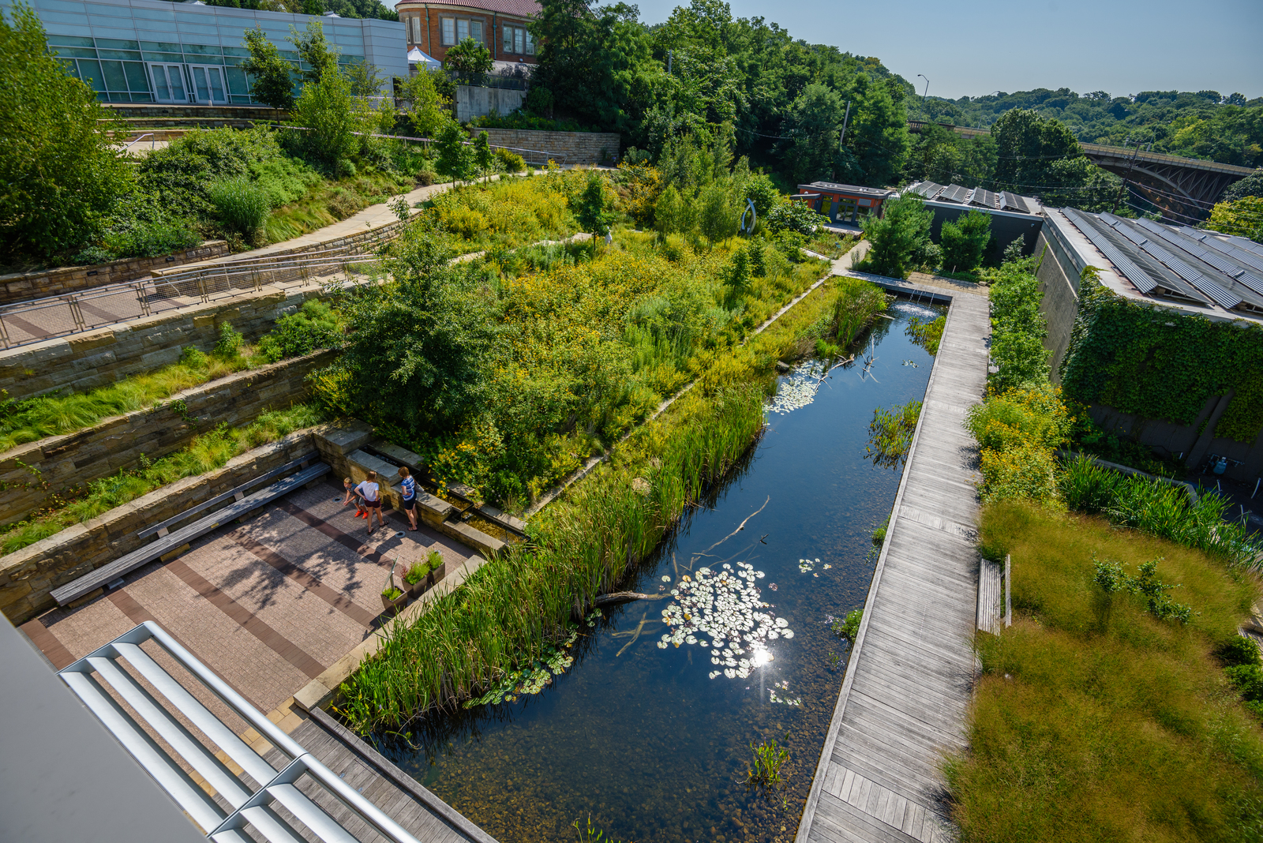
SITES in 10
Notes:
30 seconds
1. Good Morning/Afternoon/Evening, I am … and I will be providing a summary of why the Sustainable SITES Initiative, “SITES”, is the best framework for site planning and design on your projects.
2. What is SITES? It is a comprehensive, voluntary land design and development rating system being used by both private and public sectors all around the world.
3. What is its purpose? SITES drives sustainability beyond the building: from streetscapes & urban plazas to parks and natural landscapes.
Image: Phipps' Center for Sustainable Landscapes, Pittsburgh, PA (http://www.sustainablesites.org/phipps-center-sustainable-landscapes )

Slide 2
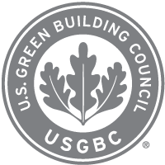



SITES Partners
SITES in 10
Notes:
30 seconds
1. SITES was developed through a partnership between the American Society of Landscape Architects, the Lady Bird Johnson Wildflower Center, and the US Botanic Gardens.
2. The first guidelines (V1) were published in 2009. The SITES v2 Rating System and Reference Guide were released in 2014.
3. It is now administered by GBCI (Green Business Certification Inc), the same 3rd party certification body as LEED.
4. SITES certification is given to landscapes, site infrastructure, and spaces that demonstrate a high level of environmental and social sustainability.
Like LEED, there are 4 certification levels (Certification, Silver, Gold, Platinum).
A LEED v4 project can now automatically earn all of the points in the Sustainable Sites credit category in LEED when they achieve SITES v2 Gold certification or higher on the same project. As part of this, projects would not need to separately document their LEED Sustainable SITES credits after achieving SITES certification. This is designed to recognize the projects that are going above and beyond by attempting both rating systems, and to reward them for their efforts.
Add’l speaker notes:
The SITES and LEED rating systems are complementary and can be used independently or in tandem. If you would like your project to benefit from certifying to both SITES and LEED, you can take advantage of the synergies between them. As a reminder, the LEED rating system applies to your project building and the site it is located on, while the SITES rating system applies to everything on your site, except your building (with a few exceptions).
Review the LEED-SITES Synergies documents to learn more about how SITES interfaces with LEED BD+C and ND rating systems (v4/v2009). http://www.sustainablesites.org/resources

Slide 3
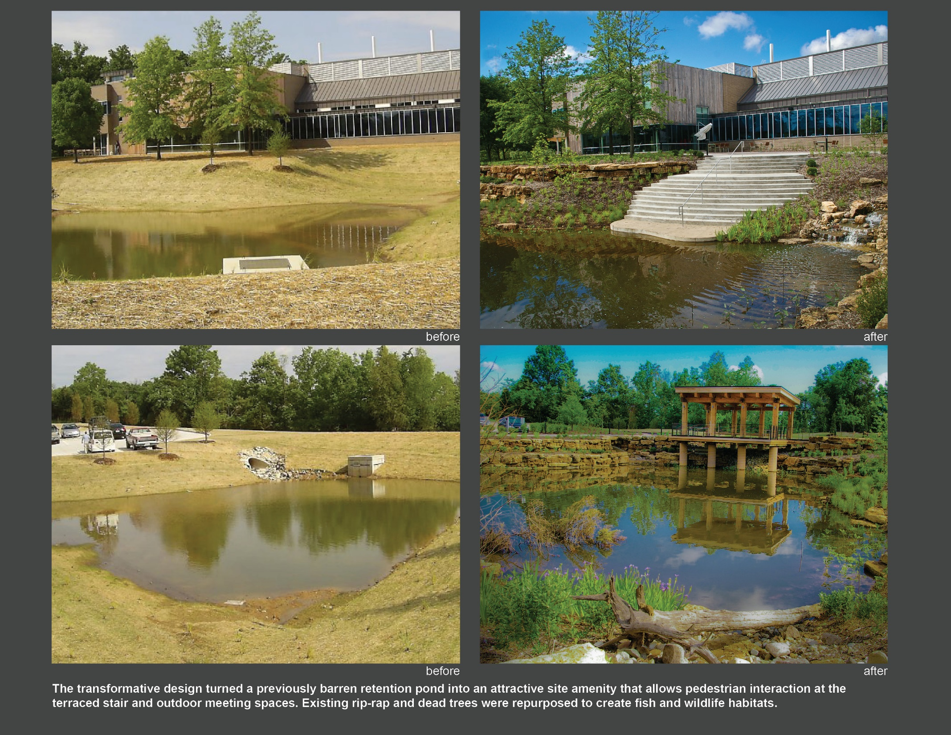
SITES Drives Transformation:
Before & After
SITES in 10
Notes:
30 seconds
1. SITES drives the dramatic transformation of landscapes and generates economic, social, & ecological value.
2. SITES aligns land development and management with innovative sustainable design through 4 goals:
a. Creating regenerative systems and fostering resiliency;
b. Ensuring future resource supply and mitigating climate change;
c. Transforming the market through design, development, and maintenance practices; and
d. Enhancing human well-being and strengthening community.
For reference only:
Images:
LEFT: Before / after images of Hunts Point Landing in Bronx, New York, where they turned this paved dead-end street into a vibrant 1.5-acre park. This project was a brownfield and located in a highly-urbanized industrial and commercial area. This project restored the waterfront, treated stormwater runoff on site, and re-used many of the onsite materials in the final design. Although the street ended in little more than a desolate slab of asphalt that had few visitors, it was one of the spots where fishermen for ages cast lines. A key project goal was to integrate public recreation with sustainable design practices. The site was transformed into a lush green space of native vegetation with sustainable solutions for water treatment using wetlands and bio-filtration pools and reef balls at the water’s edge for oysters and mussels to spawn. It also now offers a fishing pier, kayak launch, boat storage and tidal pools. The site’s linear shape was used to organize program activities that transition from more active and intensively used in the upland sector to more passive and water-based toward the restored shoreline. Surrounded by industrial, commercial and residential uses, the park now provides a safe, accessible location for fishermen to pull in their daily catch and families to gather for a weekend picnic. (http://www.sustainablesites.org/hunts-point-landing )
RIGHT: (Before / after images) Novus International Headquarters Campus, located at the Missouri Research Park in St. Charles, Missouri, is a nine-acre site that has been developed to a new standard for sustainable site design. The intent of the campus master plan is to preserve and enhance natural habitats, focus on improving vegetation and hydrology of the site, and create an active and healthy environment that employees can be proud of and inspired to interact in. The project addresses several sustainable design best practices including hydrology, wildlife habitat enhancement and monitoring, improved soils and vegetation. There is an emphasis on using regional materials and implementing features that address human health and well-being of site visitors and employees. (http://www.sustainablesites.org/novus-international-headquarters-campus )

Slide 4
SITES in 10
Notes:
30 seconds
1. SITES is
a. Flexible and adaptable to all types of projects
b. With or without a building for
c. New construction on undeveloped landscapes or major renovation of existing sites.
There is no maximum sized site, but the minimum site is considered 2,000sf; budgets typically range from less than $20,000 to over $20 million.
Today, there are nearly 170 registered and certified SITES projects. 18 of those were certified using the current SITES v2 Rating System.
Top Left: Washington Canal Park, Washington, DC (http://www.sustainablesites.org/washington-canal-park)
Top Center: Meadow Lake / Main Parking Lot at the Morton Arboretum, Lisle, IL (http://www.sustainablesites.org/meadow-lake-main-parking-lot-morton-arboretum)
Top Right: Swaner Ecocenter, Park City, UT (http://www.sustainablesites.org/swaner-ecocenter)
Middle Left: Perkins+Will Atlanta Office, Atlanta, GA (http://www.sustainablesites.org/perkinswill-atlanta-office)
Middle Center: Taylor Residence, Kennett Square, PA 9http://www.sustainablesites.org/taylor-residence)
Middle Right: 38 Dolores, San Francisco, CA (http://www.sustainablesites.org/38-Dolores)
Bottom Left: Bat Cave Draw and Visitor Center Rehabilitation, Carlsbad Caverns National Park, NM (http://www.sustainablesites.org/bat-cave-draw-and-visitor-center-rehabilitation)
Bottom Center: Benjamin P. Grogan and Jerry L. Dove Federal Building, Miramar, FL (http://www.sustainablesites.org/us-federal-office-building )
Bottom Right: Burbank Water and Power – Ecocampus, Burbank, CA (http://www.sustainablesites.org/burbank-water-and-power-ecocampus)

Slide 5
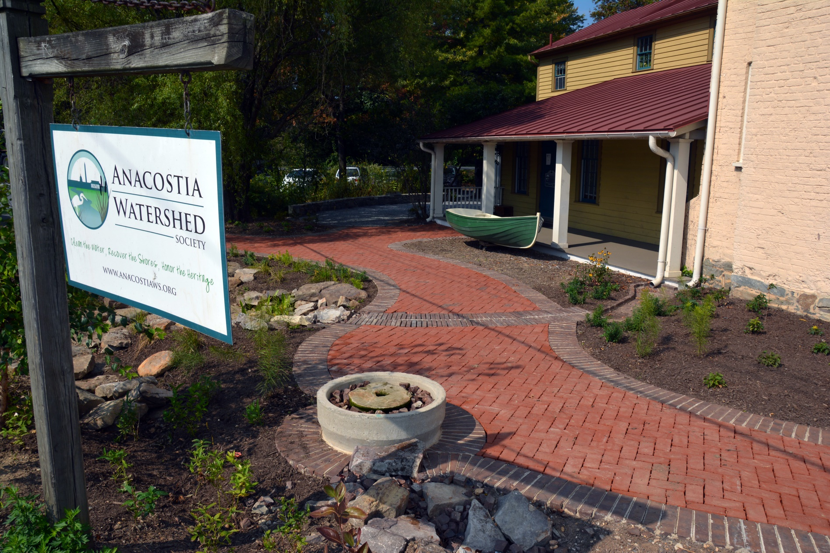
SITES Provides the Best Tool for ROI
SITES in 10
Notes:
30 seconds
1. Given the applicability of SITES to almost any project, the real question is, “Why not use the rating system?”
2. The answer we typically hear is, “It costs time and money.”
Because there is an investment to pursue SITES certification, we will explore this through the lens of your return on investment.
Images:
Left: Anacostia Watershed Society Headquarters, Bladensburg, MD (http://www.sustainablesites.org/anacostia-watershed-society-headquarters )
Right: Phipps' Center for Sustainable Landscapes, Pittsburgh, PA (http://www.sustainablesites.org/phipps-center-sustainable-landscapes )

Slide 6
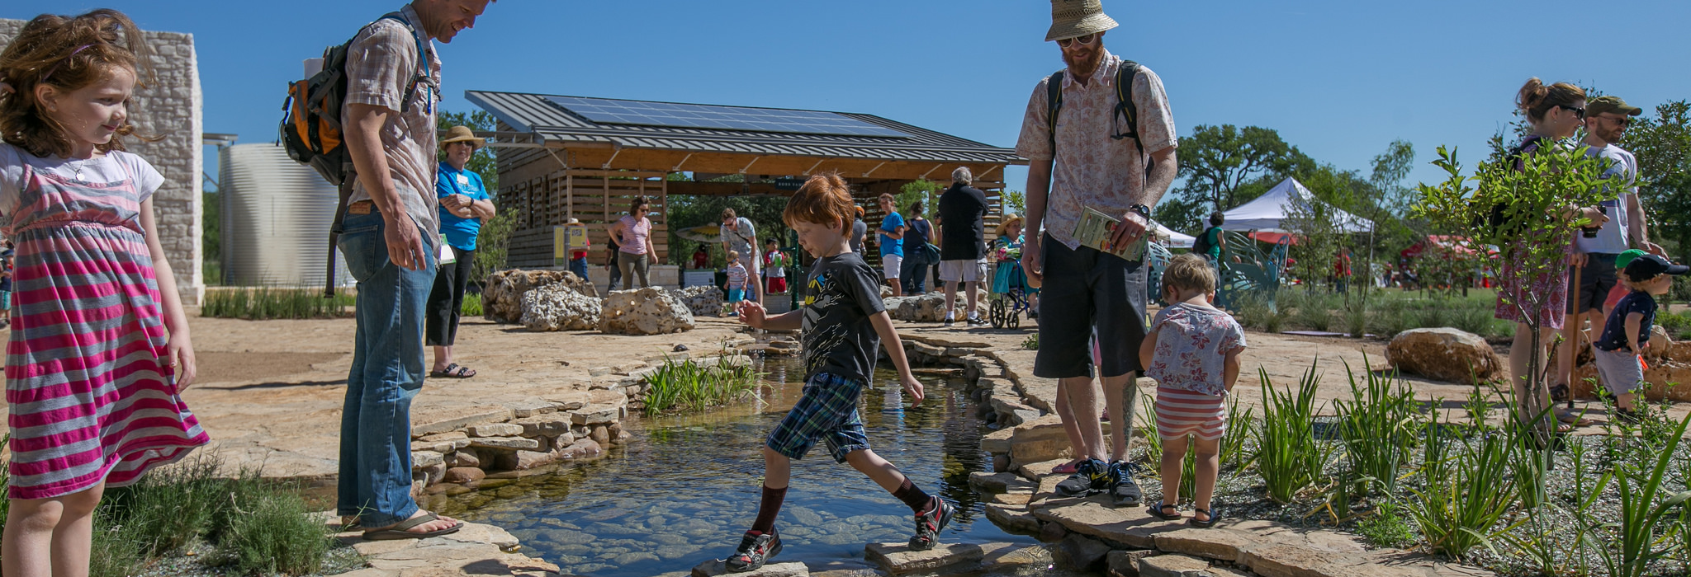
SITES Framework
SITES in 10
Notes:
20 seconds
1. The next slides provide several arguments supporting the SITES framework as the best tool to meet your project’s goal
a. It establishes a concise framework establishing goals & fostering team collaboration
b. It considers operations and maintenance improving site resiliency and reducing upkeep costs
c. It provides accountability for best practices in sustainability
Image: Luci and Ian Family Garden at the Lady Bird Johnson Wildflower Center, Austin, TX (http://www.sustainablesites.org/luci-and-ian-family-garden-lady-bird-johnson-wildflower-center )

Slide 7
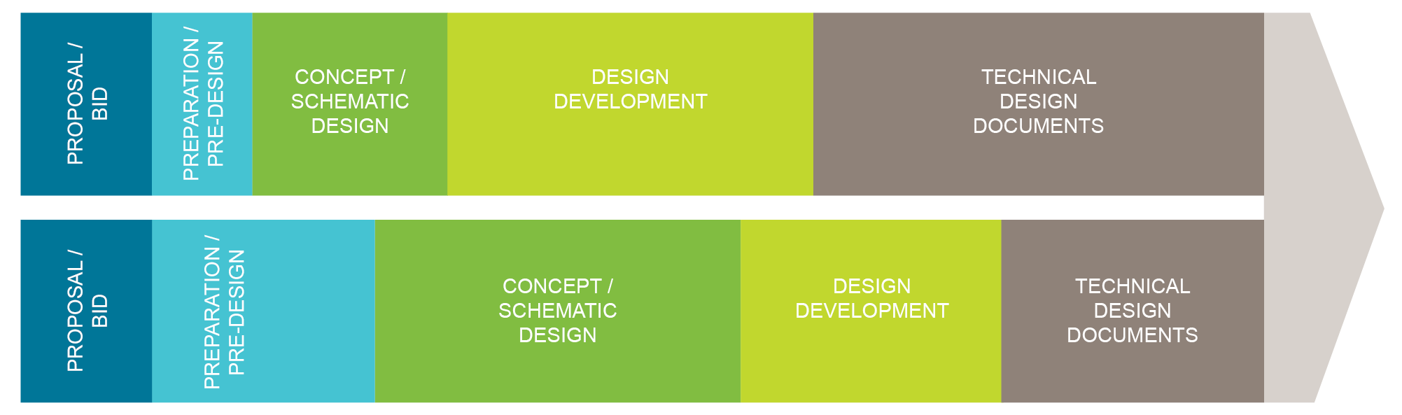
Integrative Design Process
STANDARD DESIGN PROCESS
INTEGRATIVE DESIGN PROCESS
SITES in 10
Notes:
20 seconds
1. Let’s look at the first argument: SITES provides a concise framework establishing goals & fostering team collaboration
2. How is this accomplished? SITES requires an integrative design process:
a. The entire team must be established early
b. Strategies and solutions chosen by the team are practical and measurable
The framework provides a “menu” of choices covering site analysis to design and construction to maintenance
WHY? – reduced change orders, less costly revisions during early design phases, upfront thinking is good investment in process, most costly / biggest decisions should happen early in design phase -

Slide 8
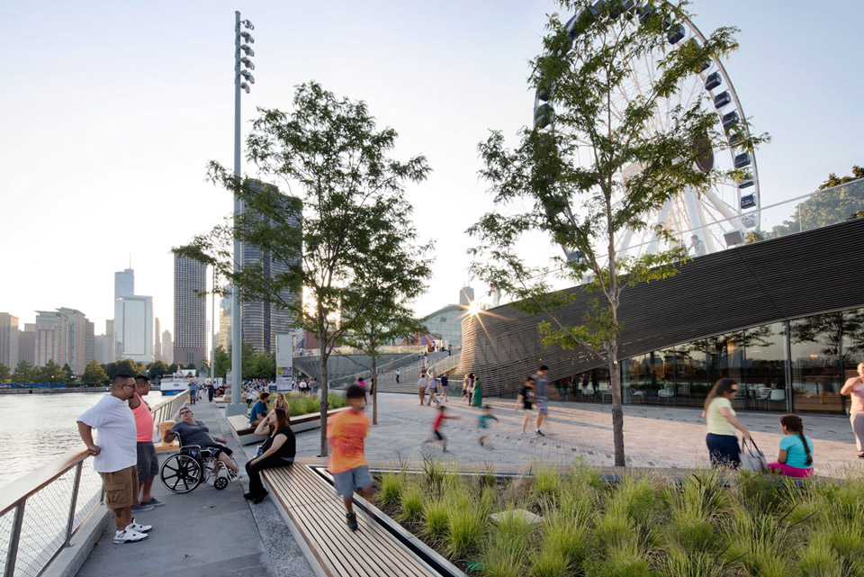
Collaborative, Solution-Oriented Thinking
“SITES makes you think through the site before you begin design. It forces you to use a quantifiable framework that creates learning opportunities … for learning. Challenges create growth and ultimately value… I believe that SITES will drive the industry to become more sustainable and transparent.”
– Bryan Astheimer, SITES AP
Revision Architecture
SITES in 10
Notes:
30 seconds
Establish sustainability goals for your project at the beginning to help make those big design decisions that will create the framework for your design process
“SITES encourages project teams to have a better understanding of site attributes and material and labor procurement options before design begins. On Chicago's Navy Pier project for example, this discovery process resulted in the design team identifying and coordinating with local plant nurseries that could meet our massive plant volume and diverse mix of native plant palette needs early on. Not performing this kind of site attribute or supplier discovery early can result in costly project delays, unexpected costs, or missed sustainability performance targets. The learning curve and challenges of using SITES ultimately results in project team knowledge growth and value add to the project. I believe that SITES will drive the landscape and public realm industry to work smarter and to be more sustainable and transparent.” – Bryan Astheimer, SITES AP, Revision Architecture
Image: Chicago Navy Pier, Chicago, IL (http://www.sustainablesites.org/chicago-navy-pier )

Slide 9
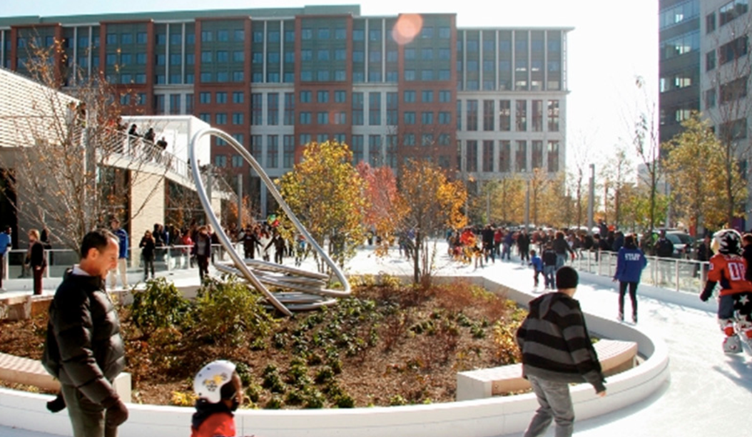
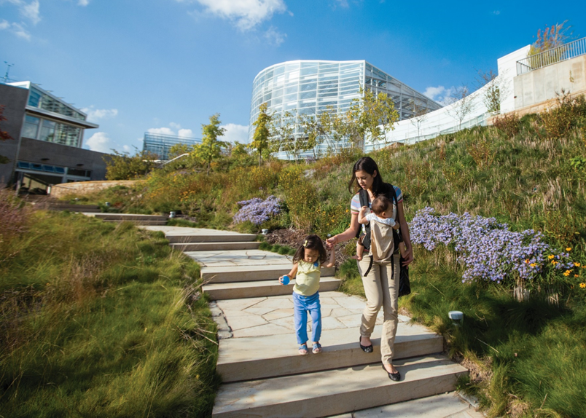
Construction & Maintenance
Canal Park (left) , Washington, DC
  886,000 gallons of water and $4,600 savings through stormwater reuse
  12.6% and $26,000 in utility costs savings through geothermal and lighting
Phipps’ Center for Sustainability, Pittsburgh, PA
  20% maintenance savings through use of native plants
SITES in 10
Notes:
30 seconds
SITES brings the construction and maintenance trades to the table early:
a. Having everyone at the table to inform design strategies – from arborists who will oversee tree protection to construction & installation managers – is a proactive approach to reduce construction delays
b. Cost overruns are also reduced by asking the right questions by the right people before the design is too far along
Value-engineering is baked into the process, allowing all players – including review & approval agencies – to get a more accurate understanding of the final product, decreasing surprises, entitlement amendments, and changes at permitting
Images:
Left: Washington Canal Park, Washington, DC (http://www.sustainablesites.org/washington-canal-park )
Canal Park in Washington, DC saves 886,000 gallons of potable water each year by meeting 88% of the park’s needs for landscape irrigation, fountains, and the ice skating rink through stormwater reuse. When adjacent parcels are developed and tied into the system, 99% of the park’s water needs could be met. Reusing stormwater currently saves $4,600 annually. The park also reduces its annual energy consumption by 12.6%, saving almost $26,000 per year in utility costs by using geothermal ground source heat pumps for heating and cooling the pavilion and restaurant, and exterior light fixtures that use 67% less power. (reference: https://www.landscapeperformance.org/case-study-briefs/canal-park )
Right: Phipps' Center for Sustainable Landscapes, Pittsburgh, PA ( http://www.sustainablesites.org/phipps-center-sustainable-landscapes )
The native plants at the Phipps Conservatory Center for Sustainable Landscapes grounds cost $0.80 per sf to maintain, as compared to $1.01 per sf, a 20% savings. (reference: https://www.landscapeperformance.org/case-study-briefs/phipps-conservatory-center-for-sustainable-landscapes#/cost-comparison )

Slide 10
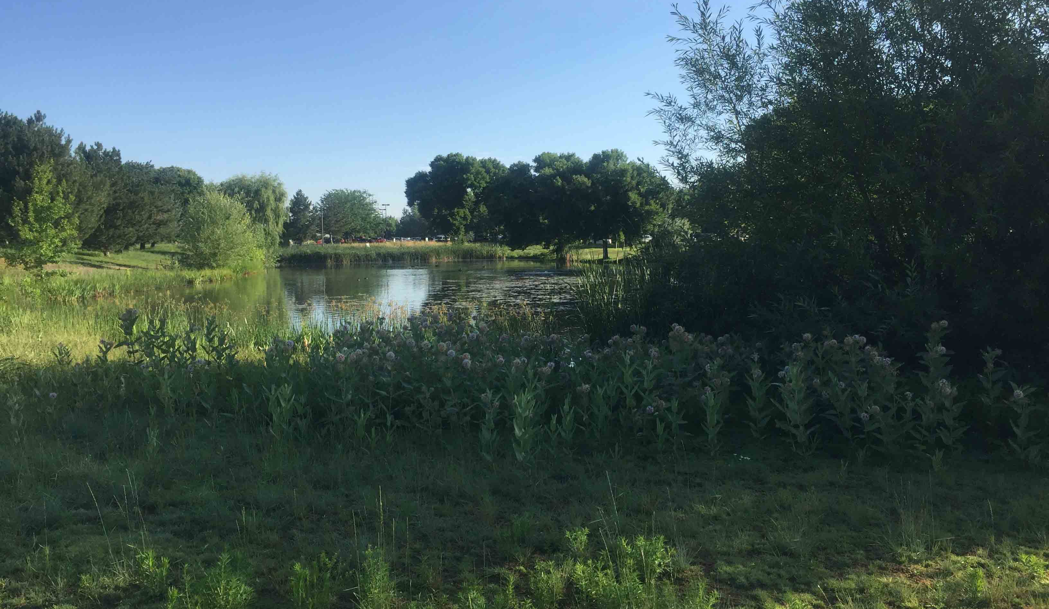
Upfront Cost & Long
Term Benefits
Hewlett Packard Campus, Boise, ID
50% cost reduction from landscape design
90% reduction in emissions for operations & maintenance
Overall reduction of operations & maintenance costs
1.9-year return on investment from reduced replacement & rehabilitation costs
SITES in 10
Notes:
20 seconds
In 2017, Hewlett Packard’s 200 acre headquarters in Boise, Idaho became the first corporate campus in the world to achieve SITES certification.
Hewlett Packard has continued its commitment with its second SITES certified project in Oregon.
“At HP, we strive to make life better for everyone everywhere – not just through technology, but through sustainability efforts within our operations and supply chain. Through this landscape project, we’re using less water, producing less emissions, and increasing bee production – ultimately protecting our planet for future generations.” - Cynthia Rock, HP Head of Corporate Real Estate and Workplace Services
The campus now saves 82,900 cubic meters of water annually, and has reduced emissions by 90 percent and landscaping costs by nearly 50 percent. HP has calculated a 1.9 year return on investment from their SITES campus renovation. (https://stackrockgroup.com/portfolio/hp-boise-campus/)
Image:
HP Inc. Boise, Idaho Campus (http://www.sustainablesites.org/hp-inc-boise-idaho-campus-number)

Slide 11
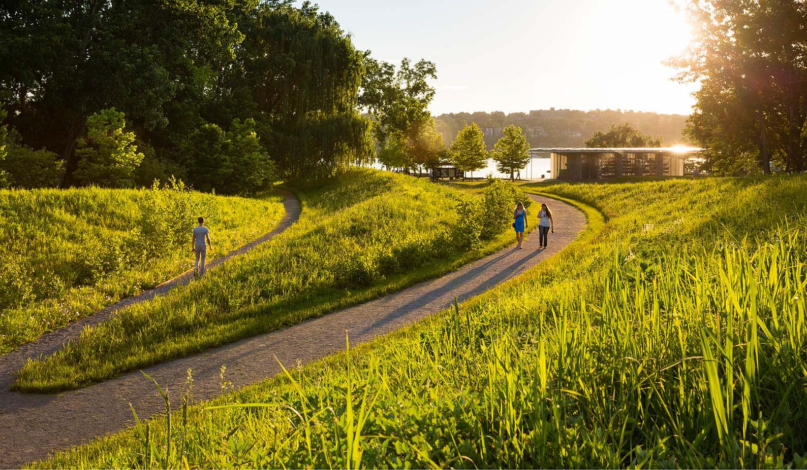
Property & Market Value
Developer can market the investment in sustainable design, health, and wellbeing
Increased property values (Green Cities: Good Health)
  7% higher rental rates for offices having high-quality landscapes
  9-12% higher spending in retail environments with high-quality tree canopy
Reduced flood risks leads to long term savings
SITES in 10
Notes:
20 seconds
1. Another important reason owners and clients decided to use rating systems like LEED or SITES is the powerful PR and storytelling benefits associated with certification. Both the public and private sectors know that sustainability is not merely an add-on to their strategies, it is a fundamental piece of their strategy.
2. SITES enables clients to walk the talk and demonstrate to prospective and current employees, visitors and other site users that they care about the environment and that they value those who are living, working and using their outdoor spaces.
It has become increasingly evident that a sound sustainability strategy drives innovation and employee engagement, it attracts people to visit and benefit from a project whether it be a park or corporate campus; it demonstrates compliance and leads to market differentiation - all key ingredients for long-term growth and profitability.
(source for notes 4-7 below: Green Cities: Good Health - http://depts.washington.edu/hhwb/Thm_Economics.html)
Averaging the market effect of street trees on all house values across Portland, OR (population 590,000) yields a total value of $1.35 billion, potentially increasing annual property tax revenues $15.3 million.
The presence of larger trees in yards and as street trees can add from 3% to 15% to home values throughout neighborhoods.
A study found 7% higher rental rates for commercial offices having high quality landscapes.
Shoppers claim that they will spend 9% to 12% more for goods and services in central business districts having high quality tree canopy.
Image: Scenic Hudson's Long Dock Park (http://www.sustainablesites.org/scenic-hudsons-long-dock-park)
2015 ASLA Award of Excellence (https://www.asla.org/2015awards/96213.html)
Scenic Hudson's Long Dock Park project transformed a 14-acre man-made peninsula on the Hudson River in Beacon, New York, from a degraded, post-industrial relic to a major waterfront park that realizes themes of recovery, remediation, reuse, and re-engagement. The project returned public access to the river, remediated contaminated soils, rehabilitated degraded wetlands, reused found materials in innovative ways, and restored ecological diversity to upland, wetland, and intertidal zones. Features include: environmental artwork by world-renowned artist, George Trakas, whose decks and docks are popular with anglers; ADA-accessible paths; areas for picnicking, river gazing, dog-walking, and Frisbee tossing; a kayak pavilion and beach for storing and launching kayaks and canoes; an outdoor classroom area; and public education and interpretive programming. The park has become a major public amenity for the Mid-Hudson Valley.
Image credit: James Ewing Photography

Slide 12
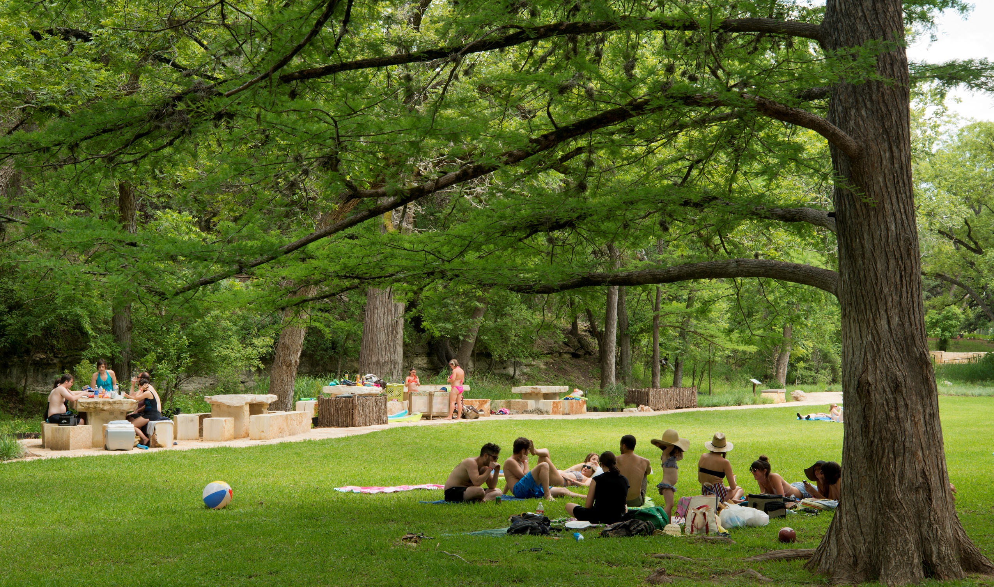
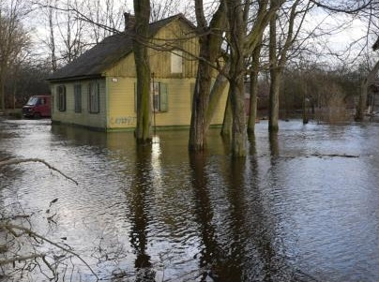
Resilience & Cost
Blue Hole Regional Park estimates annual savings of $25,500 from reduced potable water use.
Site Design Considerations
Maintenance Repairs
Restoration & Replacement
Climate Change
Risk Management & Safety
SITES in 10
Notes:
20 seconds
Another critical reason for using SITES is its inherent value in promoting resilience.
With the increasing number of extreme weather events from flooding to wildfires, it is essential we design for resilience by working with nature. This means protecting and restoring land that already provide essential functions like floodplains and managing land so we can reduce risk.
SITES helps projects prepare their homes, businesses and communities so that they can resist and avoid damage as much as possible and be able to recover quickly.
Landscapes that design for resiliency through green infrastructure are able to avoid damage, reduce risk, mitigate pollution, protect grey infrastructure
Image:
Blue Hole Regional Park, Wimberley, TX (http://www.sustainablesites.org/blue-hole-regional-park)
Increased plant species richness by 17% with the addition of 31 ecologically valuable native hardwood, prairie grass, and forb species. ﻿
Maintains or reduces stormwater runoff flow rates site-wide, despite the addition of 320,000 sf of new park development.
Saves an estimated 600,000 gallons of potable water per month by using drought tolerant turf and on-site well water for recreation field irrigation.﻿ This results in an estimated annual cost savings of $25,500.
Facts and figures above from https://www.landscapeperformance.org/case-study-briefs/blue-hole-regional-park

Slide 13
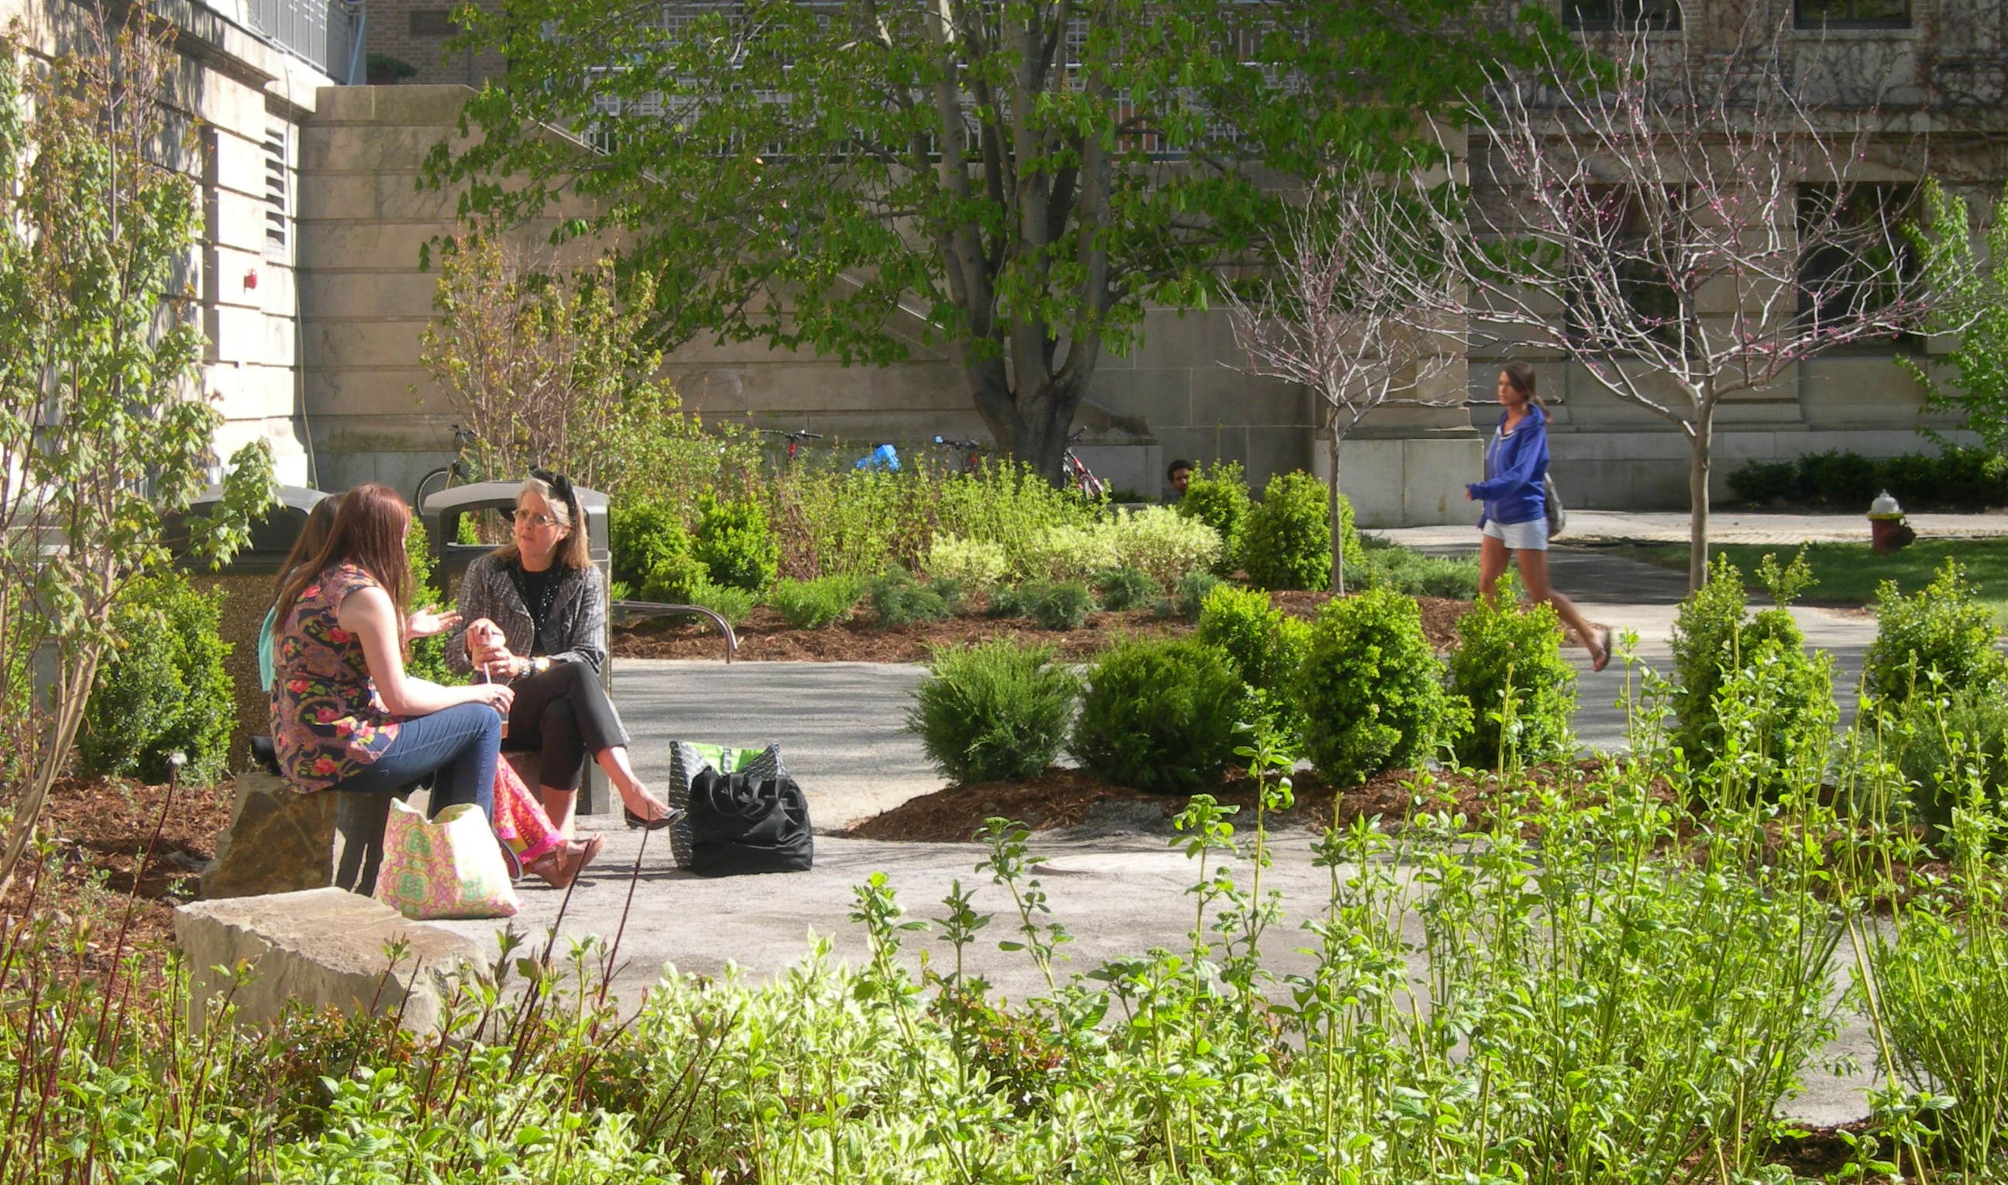
Health & Wellness
Better Air Quality
Improved Human Health & Well-Being
Increased Productivity
Lower Health Care Costs & Shortened Recovery Times
Restorative: reduces mental fatigue, alleviates stress, improves cognition
SITES in 10
Notes:
30 seconds
1. Of course, the people using the site every day are truly the ones who benefit from SITES certification.
2. SITES certified projects have better air quality, improve human health & wellbeing, and increase general productivity rates.
3. To make parks, schools and offices places where people feel good and perform well, a selection of strategies that promote efficiency and conservation must be balanced with those that address the needs of the site users and promote well-being. Ideally, the chosen strategies do both: the solutions that conserve energy, water and materials also contribute to a great outdoor experience.
4. Employees and visitors of a sustainable site can expect improvements to their health and well being, which increases productivity and overall satisfaction, and in turn, this can lower the need for healthcare.
5. For example, studies have shown that increase exposure to natural environments can help to restore the mind from the mental fatigue, alleviate stress and improve cognitive functioning.
6. Improved air quality due to more vegetation is also inherently linked to improvements in physical health.
And access and views of vegetation also translates into better performance in school and work as well as shortened recovery times in hospitals.
(source for notes 7- below: Green Cities: Good Health - http://depts.washington.edu/hhwb/Thm_StressPhysiology.html, http://depts.washington.edu/hhwb/Thm_Mental.html)
Exposure to nearby nature can effectively reduce stress, particularly if initial stress levels are high.³¹ Simply having a view of nature produces recovery benefits.
Individuals experience a greater degree of restorative experience and lower stress levels with greater duration and frequency of visits to green spaces.
Contact with nature helps children to develop cognitive, emotional, and behavioral connections to their nearby social and biophysical environments. Nature experiences are important for encouraging imagination and creativity, cognitive and intellectual development, and social relationships.
Image: Cornell University's Mann Library Entrance, Ithaca, NY (http://www.sustainablesites.org/cornell-universitys-mann-library-entrance)

Slide 14
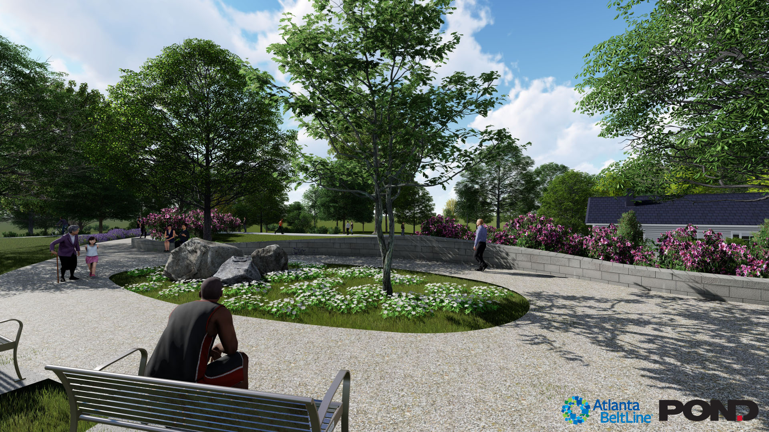
Design Forethought
"We are at 90% design drawings for a new Atlanta BeltLine project, Enota Park, and we are already seeing the results of SITES. Some team members -- not normally engaged from the beginning -- have opportunity for input from the start. This results in a much more integrated design.
And using the SITES process, we expect to see a reduction in Change Orders which will result in cost savings.“
– Kevin Burke, FASLA, Director of Design, Atlanta Beltline
SITES in 10
Notes:
20 seconds
In 2018, the 25-year Atlanta BeltLine project, which aims to connect 45 neighborhoods via a 22-mile loop of multi-use trails, modern streetcar lines and parks and open space, adopted SITES. All new designed parks in the Atlanta BeltLine are required to achieve SITES Silver or Gold certification (and have a SITES AP on the team). This makes Atlanta BeltLine the first municipal agency in the U.S. (and world) to require SITES. ( http://www.sustainablesites.org/atlanta-beltline-will-require-sites-certification-future-parks )
Image:

Slide 15
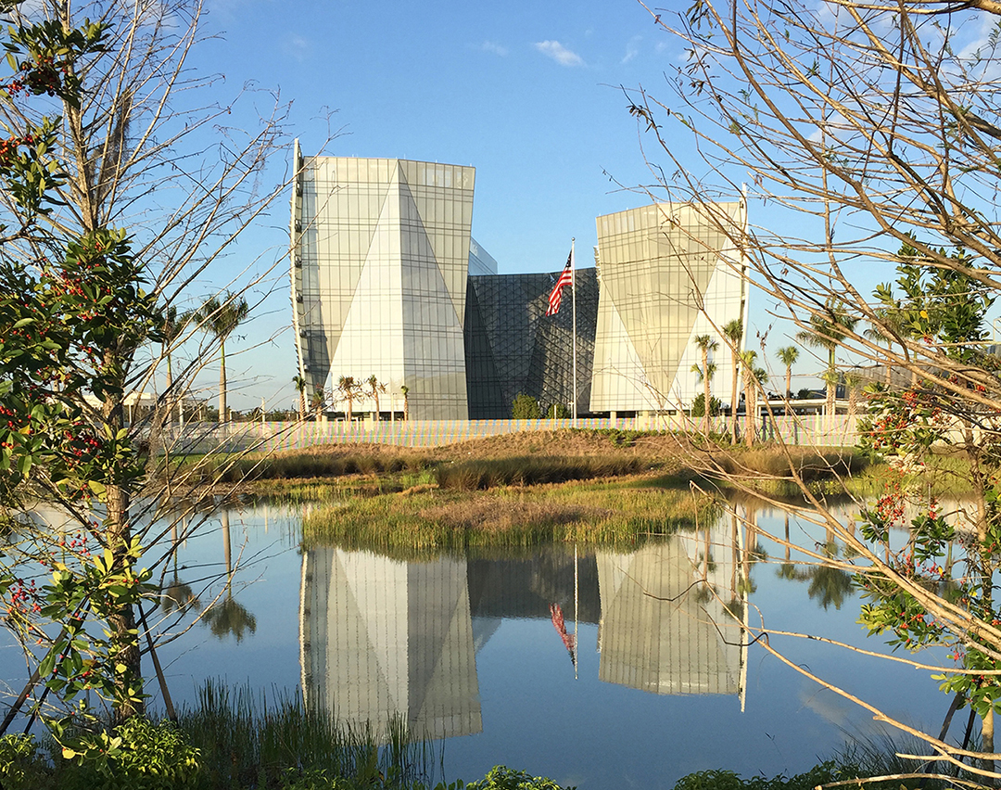
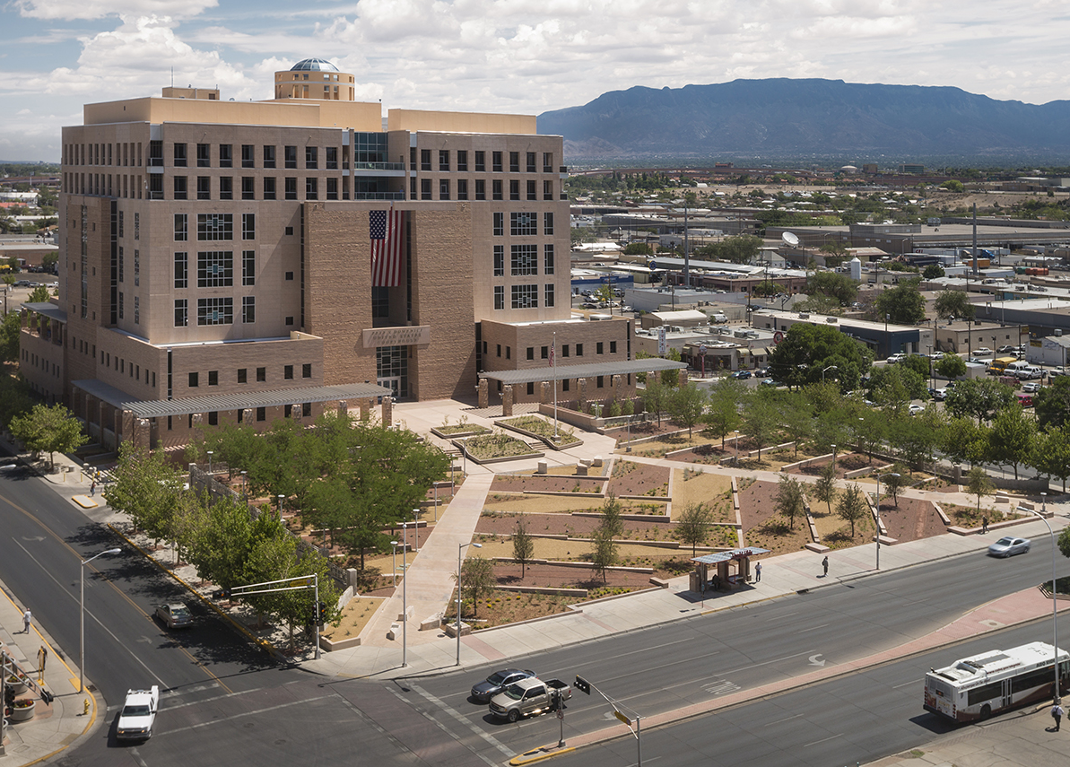
Accountability &
Best Practices
”Our incorporation of the SITES certification program provides an added focus on the quality of our site development, clear performance standards, and third-party verification; all of which help GSA meet its sustainability goals and ensure accountability in the actual performance of delivered projects.”
– Christian Gabriel, ASLA, PLA, National Design Director-Landscape Architecture, U.S. General Services Administration
SITES in 10
Notes:
30 seconds
This approach to sustainable land design and development has been supported on the US federal level.
In early 2015, the U.S. General Services Administration (GSA) adopted SITES as its new standard for GSA’s capital projects.
It is clear from this statement (in slide) from GSA’s National Design Director that SITES is a valuable tool that provides clear performance standards and ensures accountability.
In addition to office buildings and courthouses like the two shown here which achieve SITES certification during the SITES pilot program, GSA properties include land ports of entry, laboratories, post offices, and data processing centers.
The involvement of the federal government in this way is tremendously important in raising public awareness of the value of sustainably designed communities and open spaces
The federal government owns or controls some 429,000 building assets comprising 3.34 billion square feet (310.3 square kilometers) of space across 50 states.
Images:
Top: Benjamin P. Grogan and Jerry L. Dove Federal Building, Miramar, FL (http://www.sustainablesites.org/us-federal-office-building )
Bottom: Pete V. Domenici U.S. Courthouse Sustainable Landscape Renovation, Albuquerque, NM (http://www.sustainablesites.org/pete-v-domenici-us-courthouse-sustainable-landscape-renovation )

Slide 16
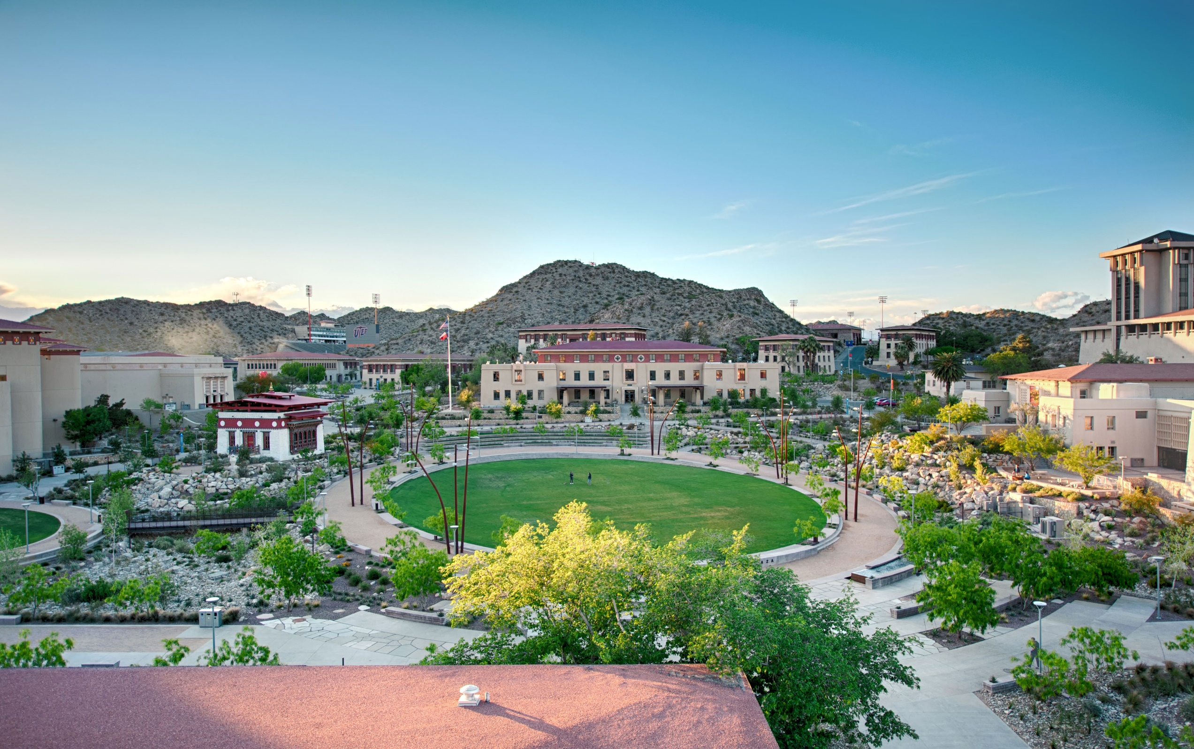
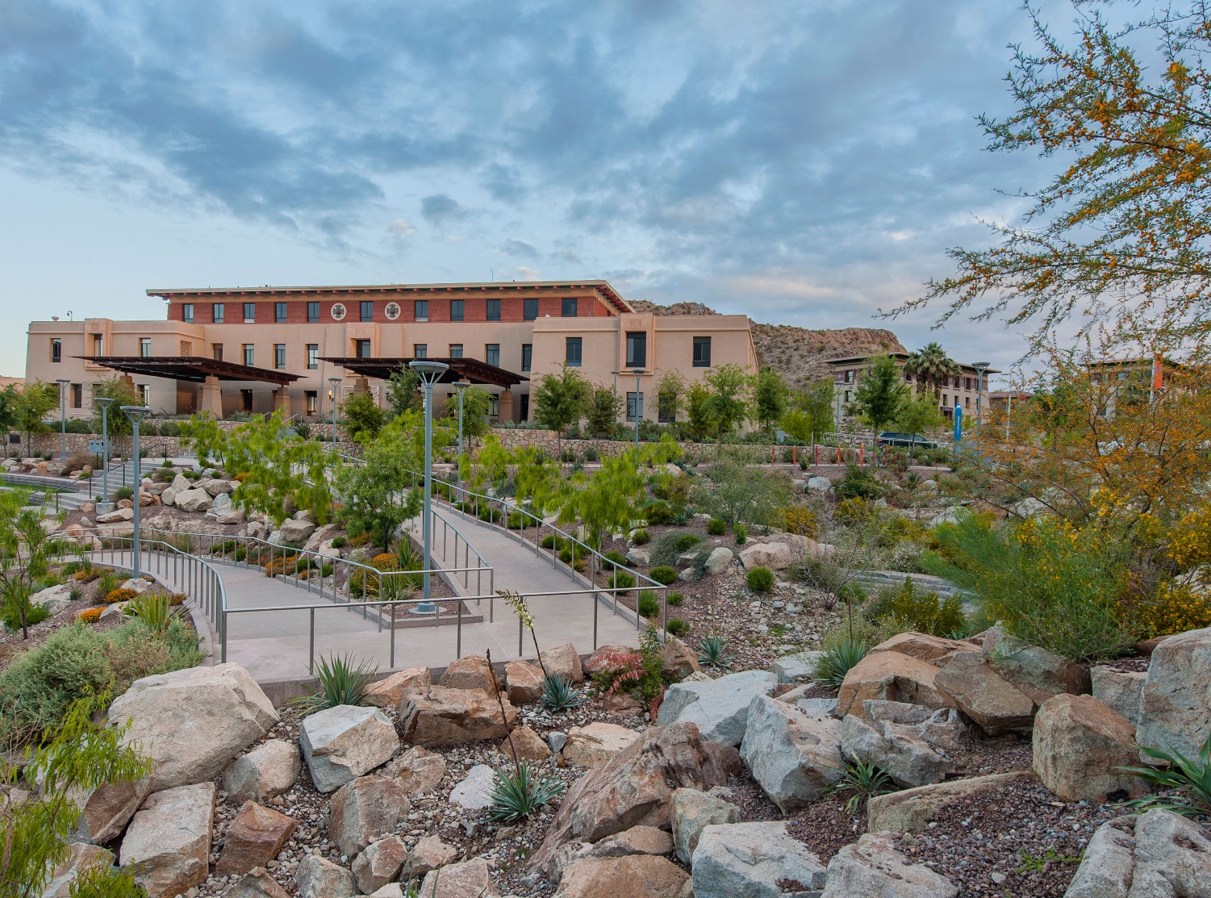
Validated Standards
Demonstrate compliance through documentation
Validate beautiful, functional, resilient places
Follow a site-specific, flexible system to meet sustainability goals
Employ best practices in landscape architecture, ecological restoration, & related fields
SITES in 10
Notes:
30 seconds
1. SITES certification involves a process that is conducted with GBCI where documentation and description is required in order to achieve the certification.
2. While the technical requirements are rigorous, the strategies and approach is very do-able and the outcome is the best performing project possible.
Careful validation ensures that SITES projects add value by creating beautiful, functional and resilient places that have multiple positive benefits for employees, visitors and the community.
Still some may ask, why should we certify? The response may be best explained by Jim Walker, the Director of Sustainability at the University of Texas (UT) at Austin. When he spoke at a conference about the campus transformation for their SITES Certified Dell Medical District, he was essentially asked this question, “Why is certification necessary? Can’t we incorporate sustainability guidelines into our projects?” His answer struck a chord with the audience: “How about we hand out college degrees because someone told us they did all the work?” UT is pursuing SITES certification, says Jim, because it is only through documentation and certification that UT will know whether a project has truly met their sustainability goals and standards.
Images: The University of Texas at El Paso's Campus Transformation Project El Paso, TX ( http://www.sustainablesites.org/university-texas-el-paso )

Slide 17
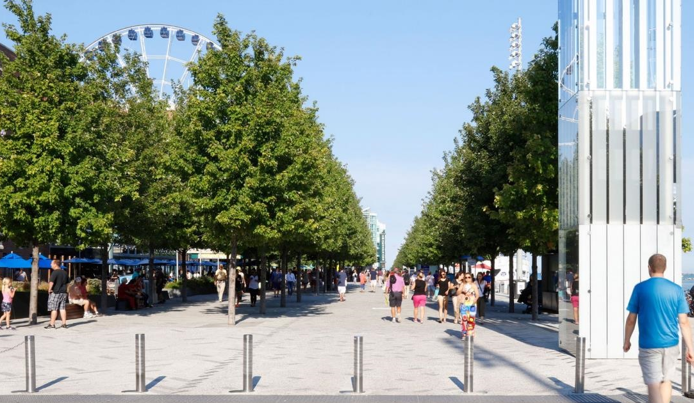
Professionalism & Leadership
“SITES was an important tool that kept our entire team accountable to a high standard of best practice and resulted in an unprecedented project – the transformation of Chicago’s Navy Pier into an authentic and green destination reflective of the city’s identity.”
– James Corner, FASLA, Founder & CEO of James Corner Field Operations
SITES in 10
Notes:
60 seconds
As noted by GSA and others, third party verification is important. It provides transparency and validation. And clients get what they pay for.
Without that assurance, projects can face various market disadvantages, such as “opportunity costs, accelerated obsolescence, or competitive disadvantage.”
On the public projects front, third-party verification is critical to showing taxpayers that their money is being well-spent on sustainable, resilient places that save energy and money.
But certification, a prominent display of leadership, also has a large impact on the community - maximizing the overall quality of life for everyone.
Images: Chicago Navy Pier, Chicago, IL (http://www.sustainablesites.org/chicago-navy-pier )

Slide 18
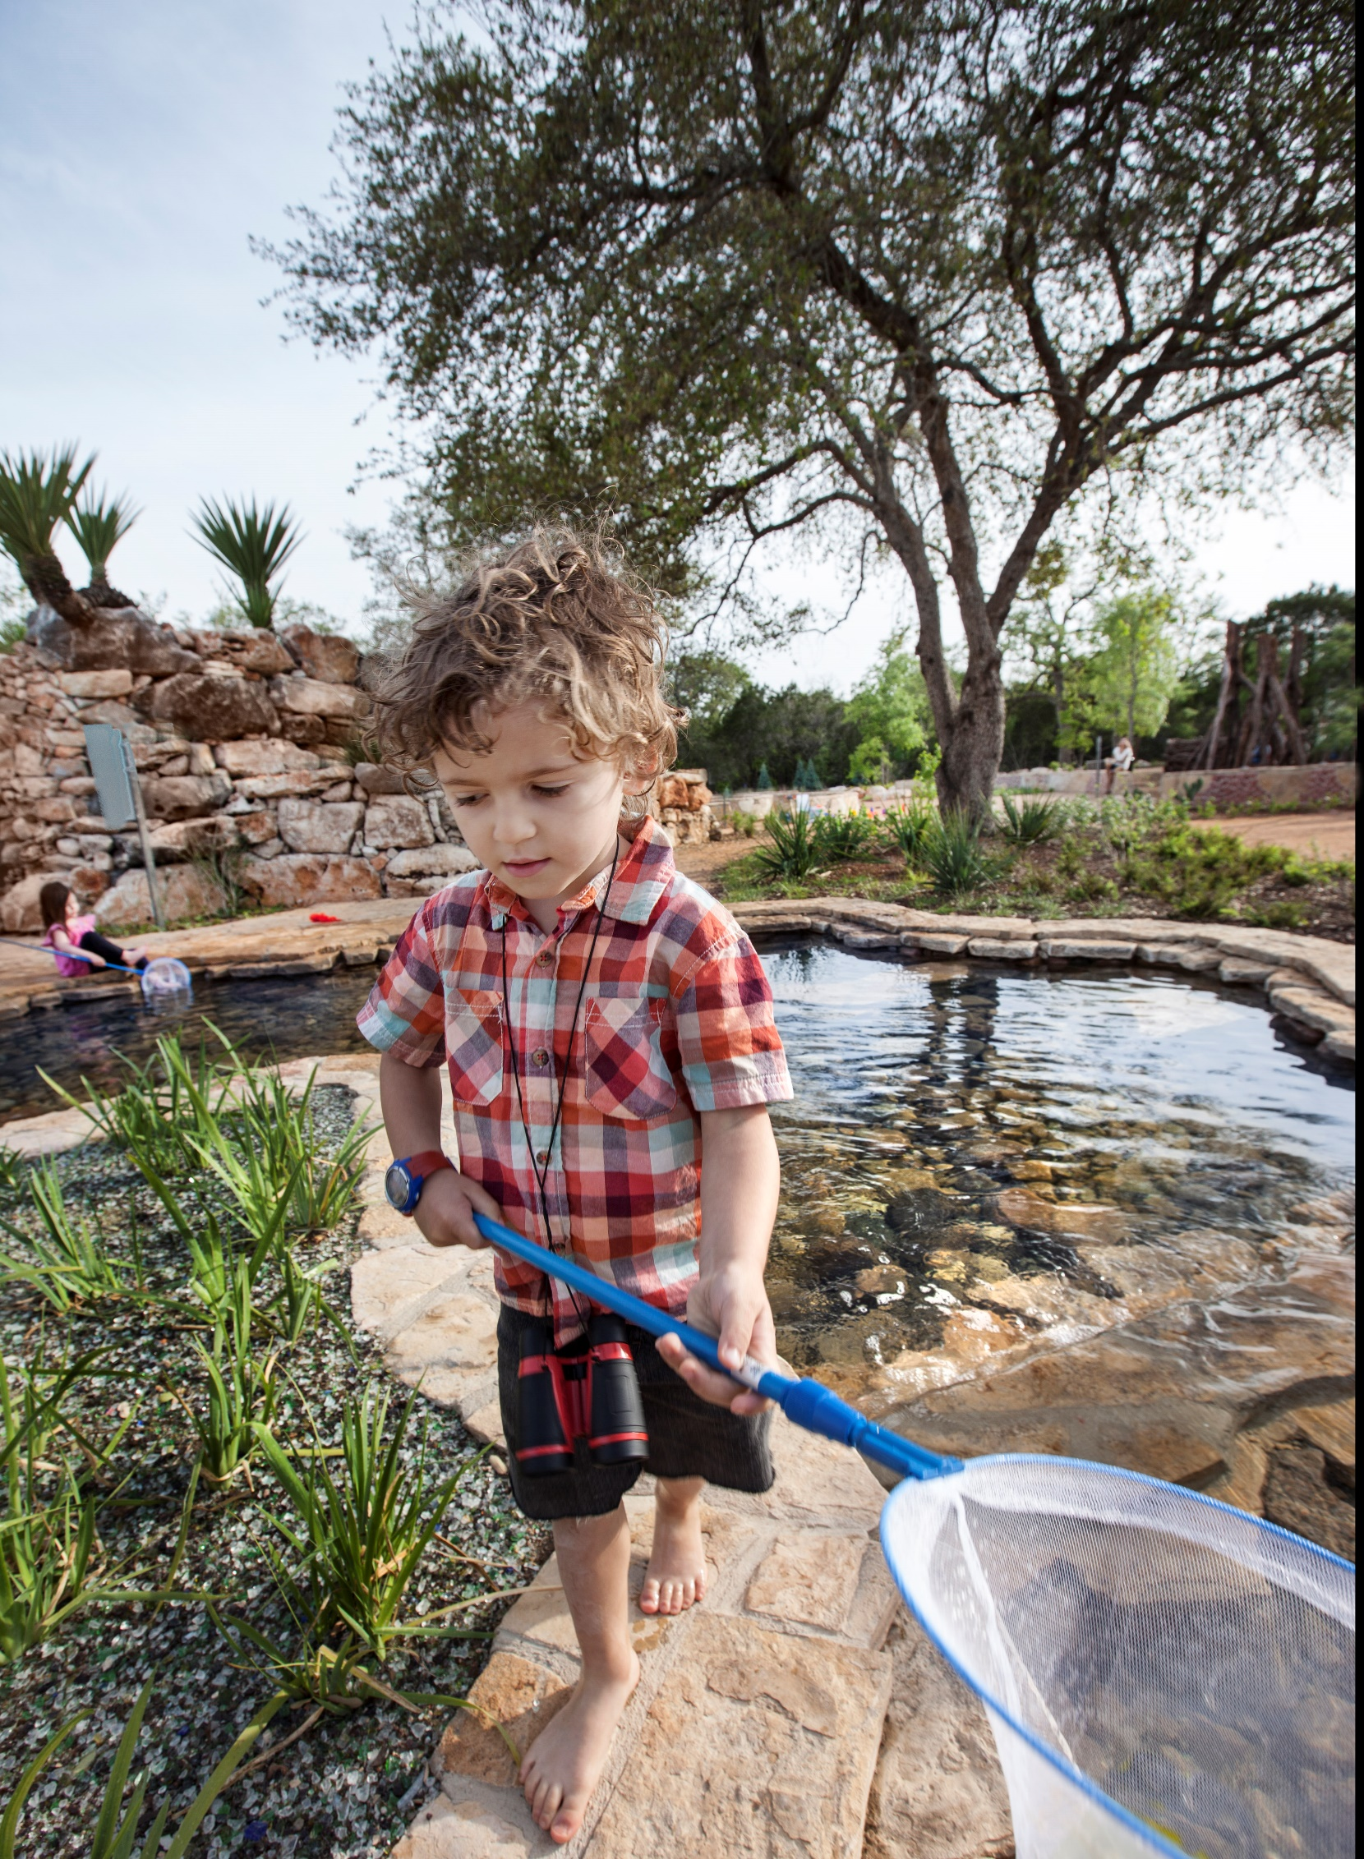
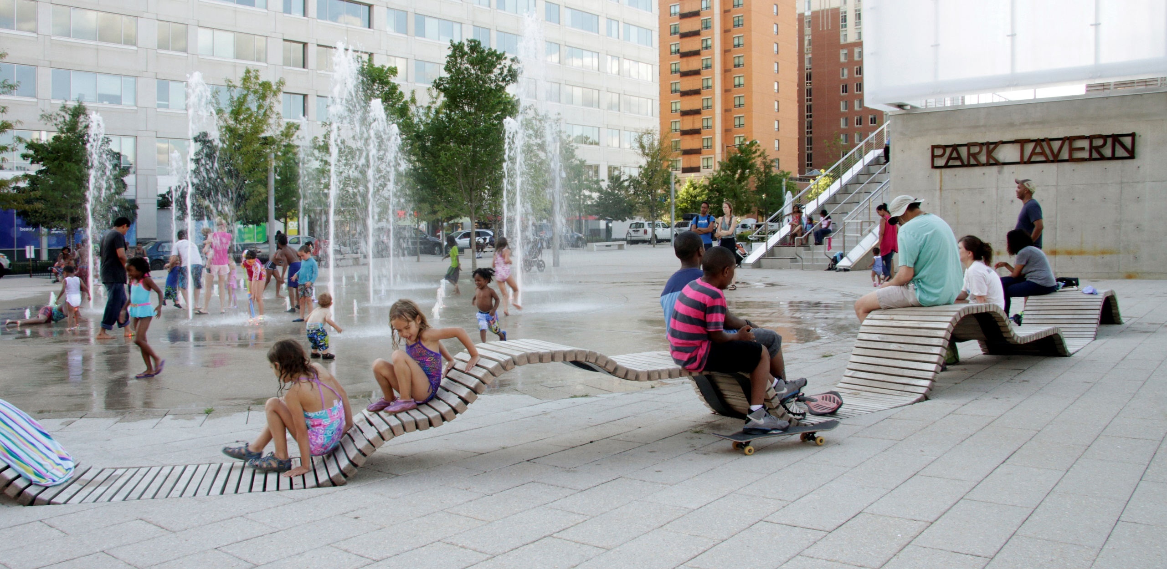
SITES IN 10
www.sustainablesites.org
This presentation was developed by the
ASLA Sustainable Design and Development Professional Practice Network
( www.asla.org/sites/ )
SITES in 10
Notes:
30 seconds
74 projects have achieved SITES certification (27 under v2)
Over 200 projects are registered and certified with SITES
Registered and certified SITES projects represent more than 740 million gross square feet of space.
There are registered and certified projects in 38 U.S. states and Washington, DC, and 14 countries outside the U.S., including Canada, Mexico, Peru, Brazil, Argentina, China, Thailand, Japan, Italy and Spain.
10 Precertified projects in U.S, China, Japan and Brazil.
Images:
Left: Luci and Ian Family Garden at the Lady Bird Johnson Wildflower Center, Austin, TX (http://www.sustainablesites.org/luci-and-ian-family-garden-lady-bird-johnson-wildflower-center )
Top right: Canal Park, Washington, DC (http://www.sustainablesites.org/washington-canal-park )

