Slide 1
LANDSCAPE
ARCHITECTURE
Presenters Name
Company/Affiliation
2016 ASLA Professional Award of Excellence, General Design
Underpass Park
Toronto, ON, Canada
PFS Studio with The Planning Partnership
Image: Tom Arban

Slide 2
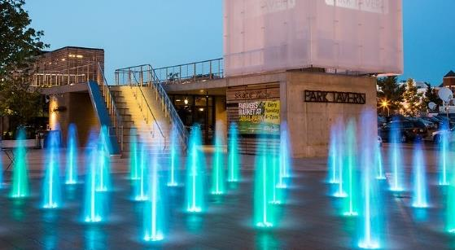
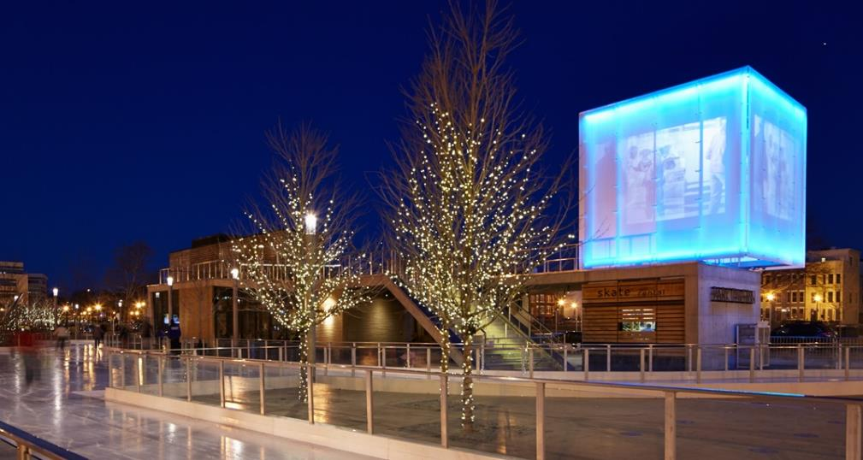
Note: Slide to include local projects near the school you are presenting. Projects that the students will be familiar with and connect with at the start of the presentation. This slide represents projects in the Washington, D.C. metro area
Example Image Credit:
Name of Project
Location
Company/Designer
Image: Name of Photographer

Slide 3
Note: Slide to include local projects near the school you are presenting. Projects that the students will be familiar with and connect with at the start of the presentation. This slide represents projects in the Washington, D.C. metro area
Example Image Credit:
Name of Project
Location
Company/Designer
Image: Name of Photographer

Slide 4
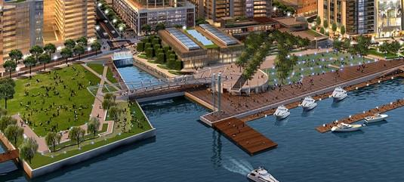
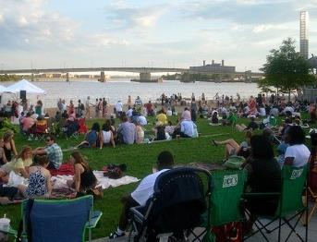
Note: Slide to include local projects near the school you are presenting. Projects that the students will be familiar with and connect with at the start of the presentation. This slide represents projects in the Washington, D.C. metro area
Example Image Credit:
Name of Project
Location
Company/Designer
Image: Name of Photographer

Slide 5
WHAT DO ALL OF THESE PROJECTS HAVE IN COMMON?

Slide 6
BUILT ENVIRONMENT:
Places that provide space for human activity, ranging from buildings to parks.
ARCHITECTS
DEVELOPERS
LANDSCAPE ARCHITECTS
PLANNERS
ECOLOGISTS
ENGINEERS

Slide 7
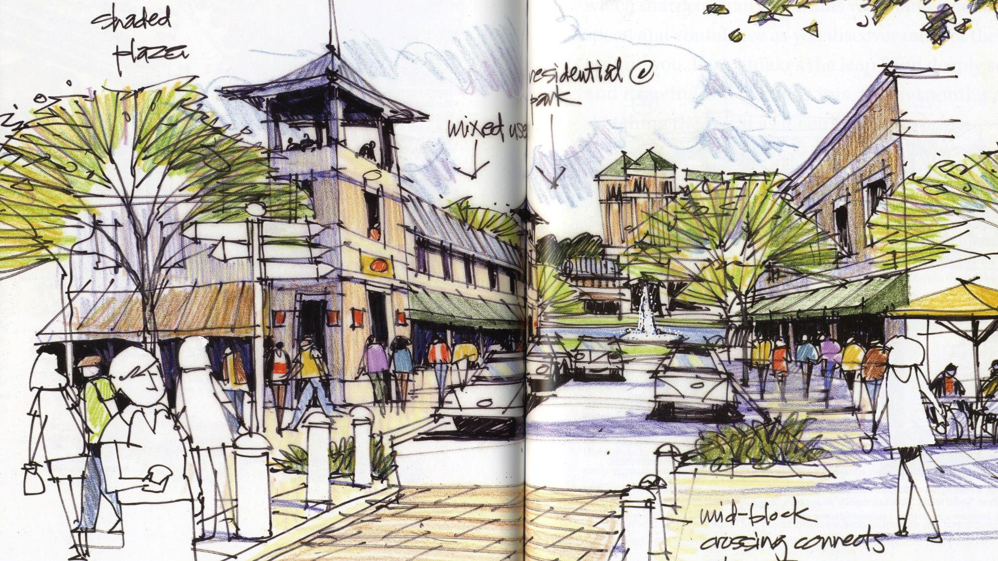
ARE YOU CREATIVE?
DO YOU LIKE TO DRAW?
2014 ASLA Professional Honor Award, Communications
Freehand Drawing and Discovery: Urban Sketching and Concept Drawing for Designers
Arlington, TX
James Richards, FASLA
Image: James Richards, FASLA

Slide 8
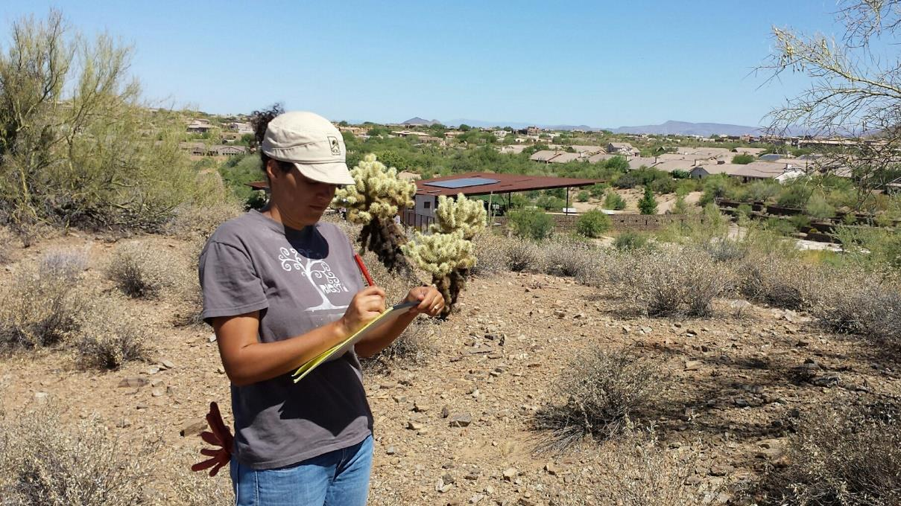
2015 ASLA Professional Honor Award, Research
Case Study Investigation
Landscape Architecture Foundation
Image: Landscape Architecture Foundation (Chris Martin, CSI 2014)
DO YOU LIKE SCIENCE AND MATH?

Slide 9
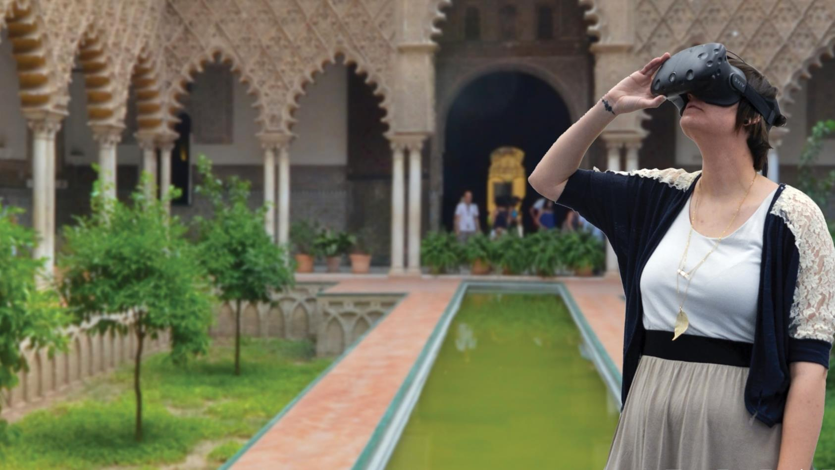
DO YOU LIKE EXPLORING TECHNOLOGY?
2017 ASLA Professional Honor Award, Research
Digital Library of Landscape Architecture History
Logan, UT
Benjamin George, ASLA
Image: Benjamin George

Slide 10
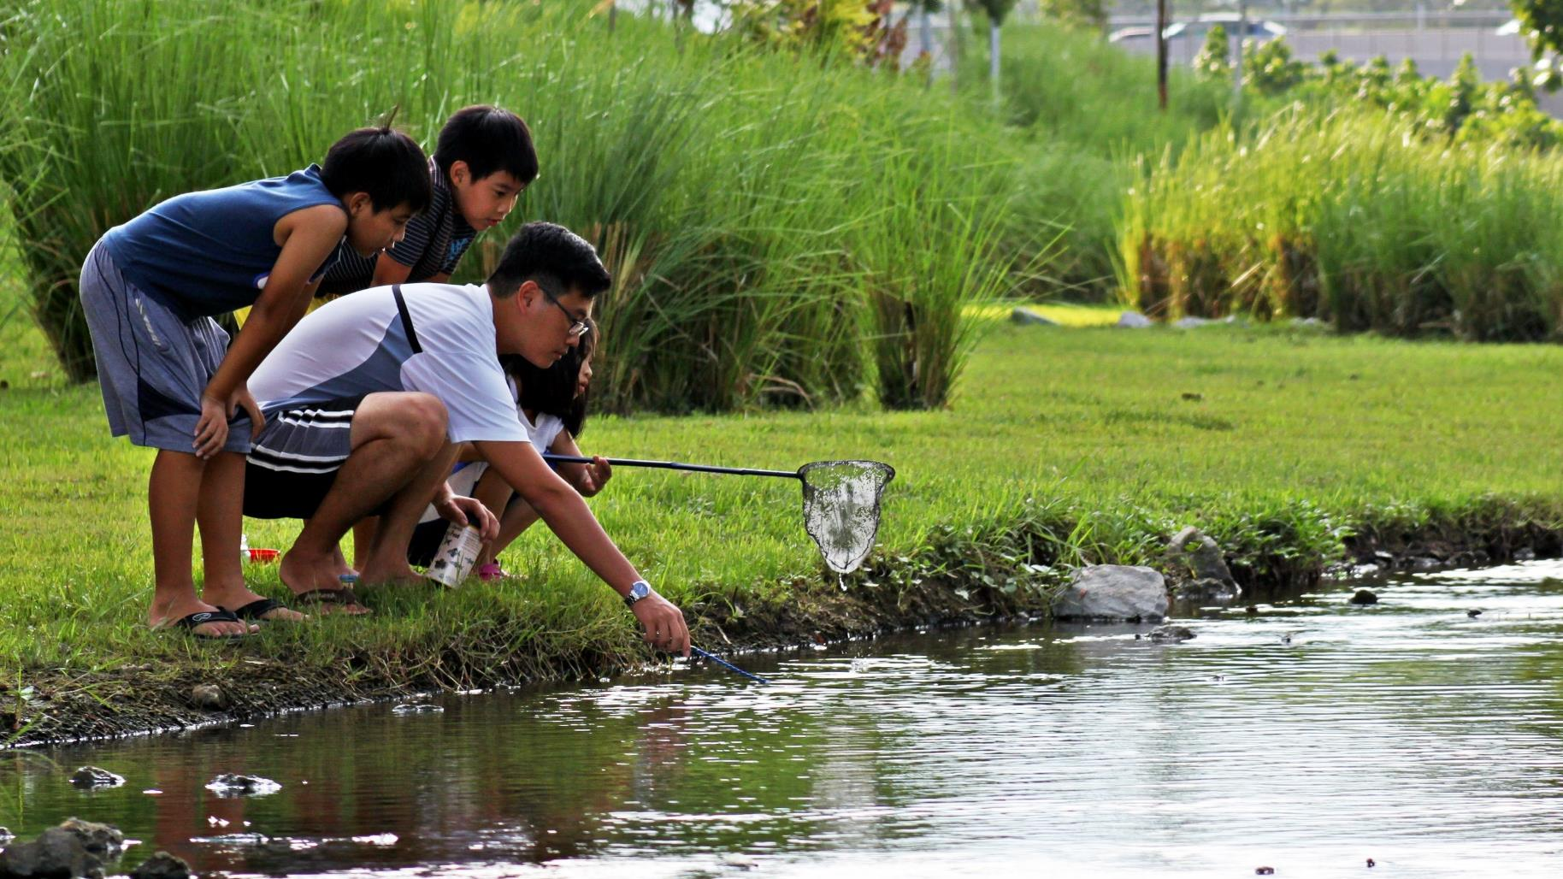
2016ASLA Professional Honor Award, General Design
Bishan-Ang Mo Kio Park
Bishan, Singapore
Ramboll Studio Dreiseitl
Image: Ramboll Studio Dreiseitl
DO YOU LIKE TO PROBLEM SOLVE?

Slide 11
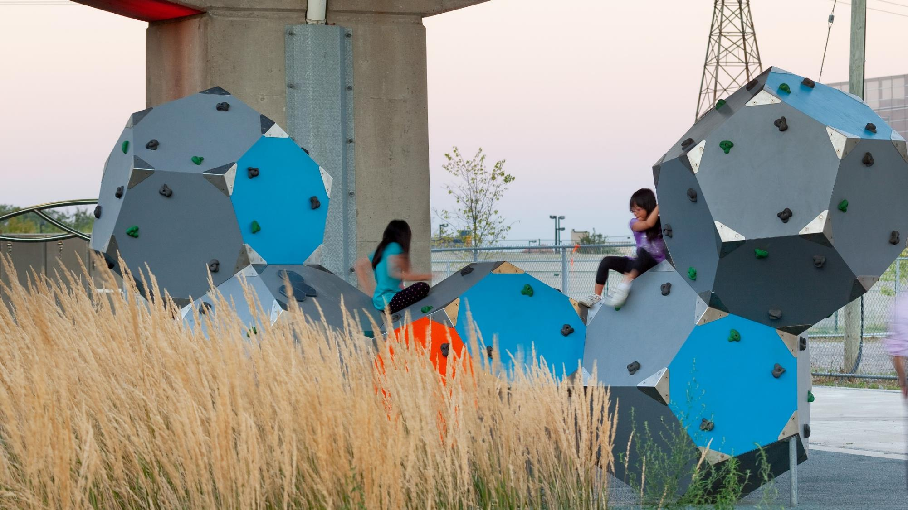
DO YOU LIKE TO HAVE FUN
WHILE YOU WORK?
2016 ASLA Professional Award of Excellence, General Design
Underpass Park
Toronto, ON, Canada
PFS Studio with The Planning Partnership
Image: Tom Arban

Slide 12
What is
LANDSCAPE
ARCHITECTURE?

Slide 13
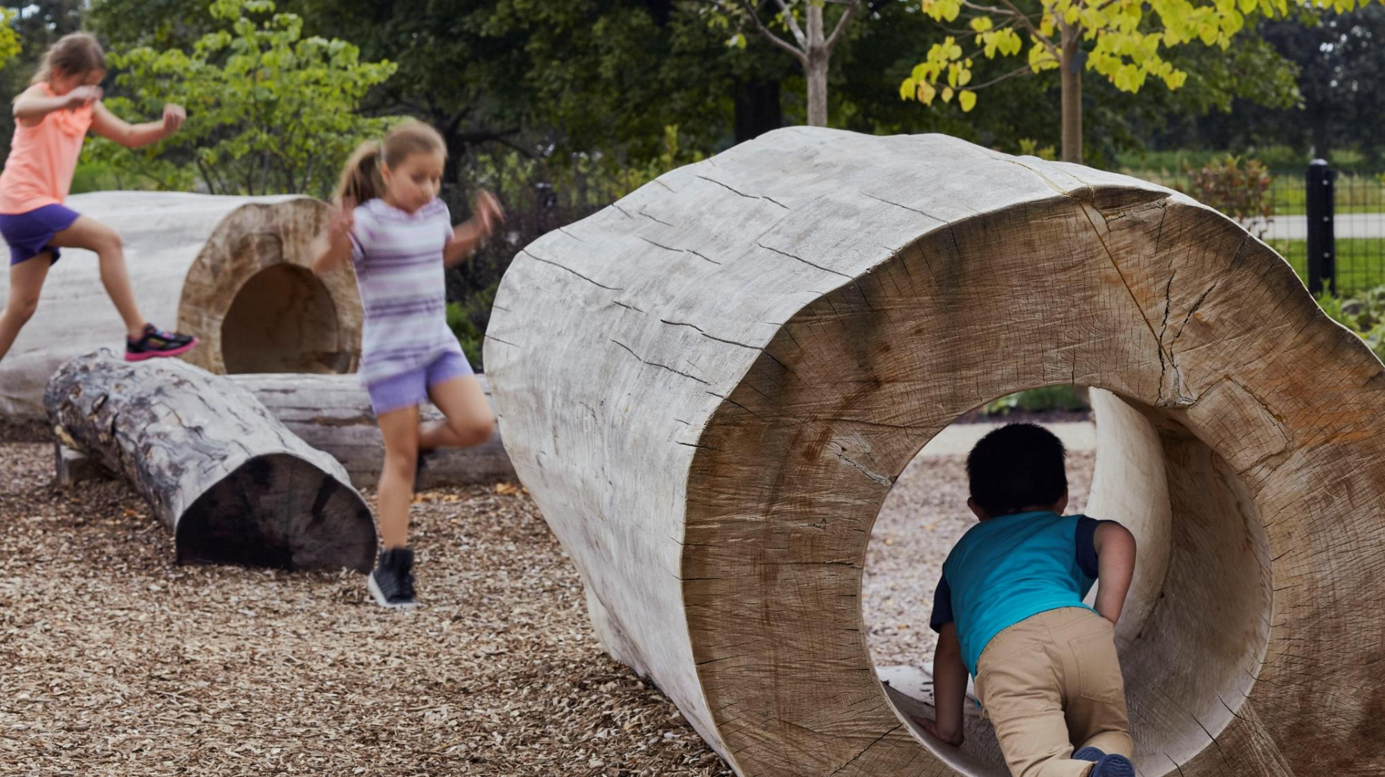
2017 ASLA Professional Honor Award, General Design
Chicago Botanic Garden
Chicago, IL
Mikyoung Kim Design and Jacobs/Ryan Associates
Image: Kate Joyce
Landscape architecture
is the work of making specific kinds of places outdoors

Slide 14
Landscape architects enhance the quality of our lives by adding beauty to the environment
2016 ASLA Professional Honor Award, Residential Design
The Rivermark
Sacramento, CA
Fletcher Studio
Image: Mariko Reed

Slide 15
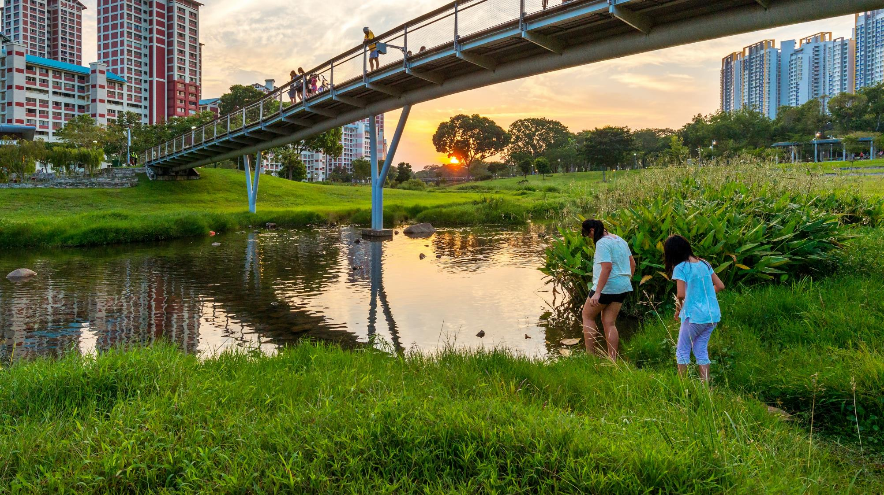
Landscape architects also solve problems, studying the environmental impact of development
2016 ASLA Professional Honor Award, General Design
Bishan-Ang Mo Kio Park
Bishan, Singapore
Ramboll Studio Dreiseitl
Image: Lim Shiang Han

Slide 16
LANDSCAPE
ARCHITECTS
are involved in the
planning and design of…

Slide 17
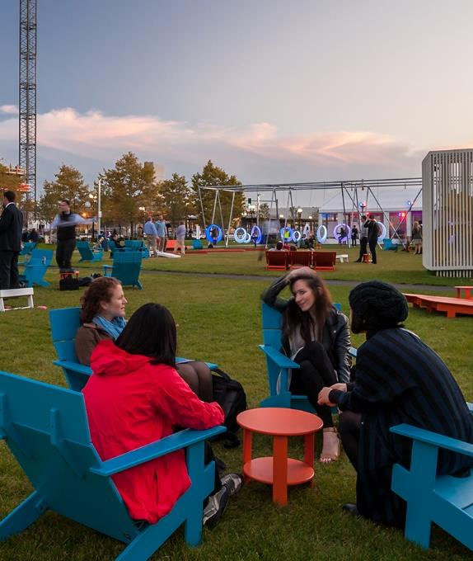
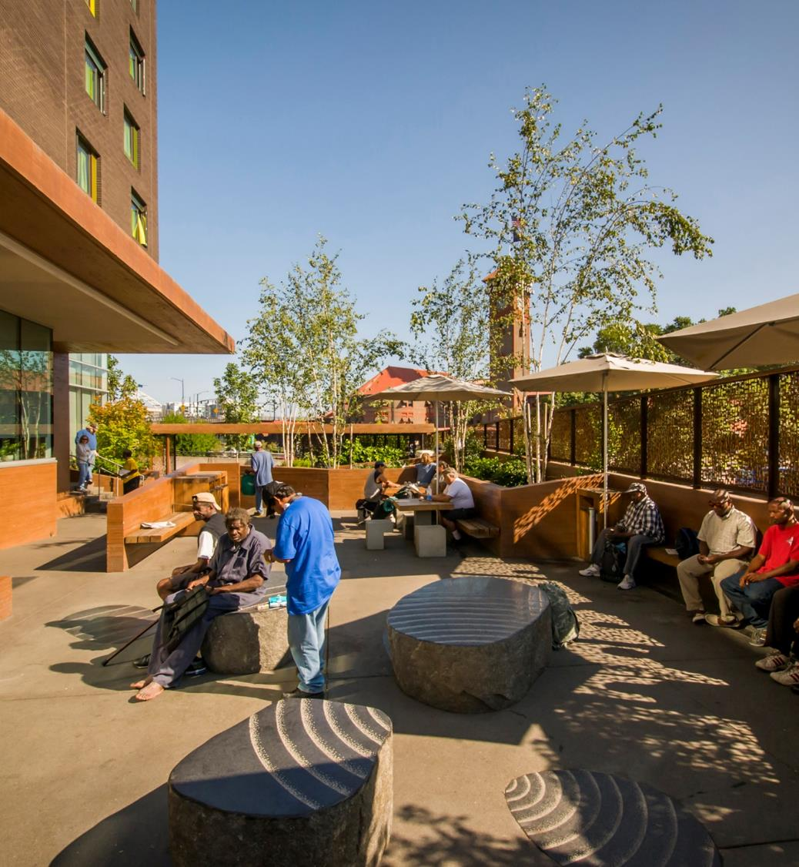
Places for people to live like communities and neighborhoods
2015 ASLA Professional Honor Award, General Design
The Lawn on D
Boston, MA
Sasaki Associates, Inc.
Image: Christian Philips Photography
2013 ASLA Professional Honor Award, Residential Design
Bud Clark Commons
Portland, OR
Mayer/Reed
Image: Bruce Forster

Slide 18
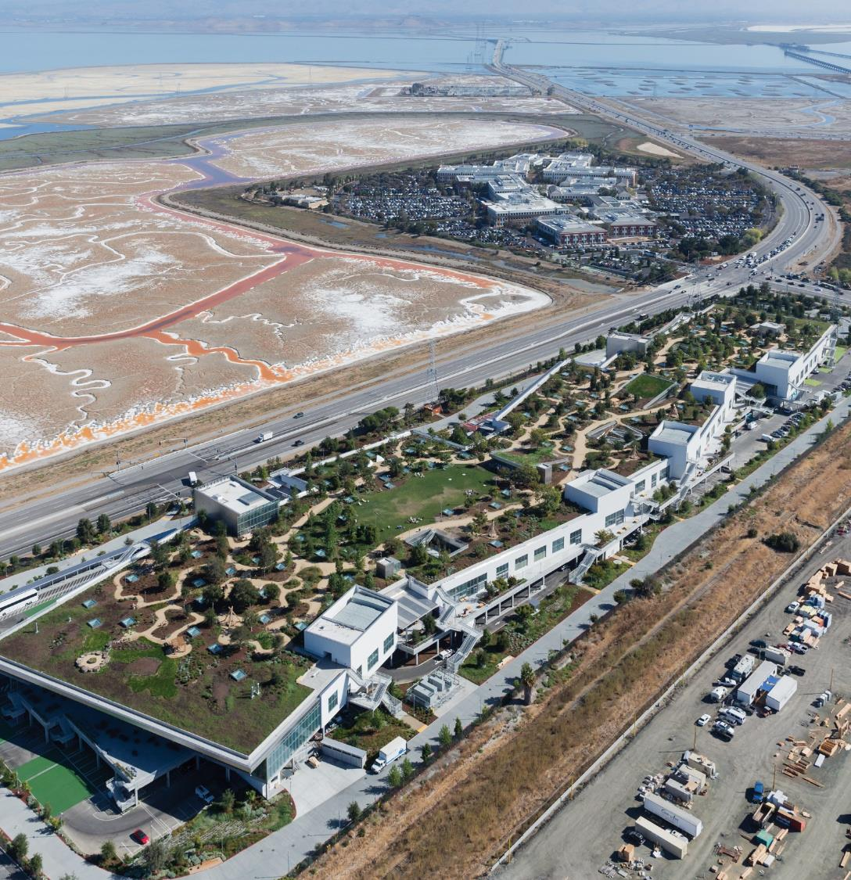
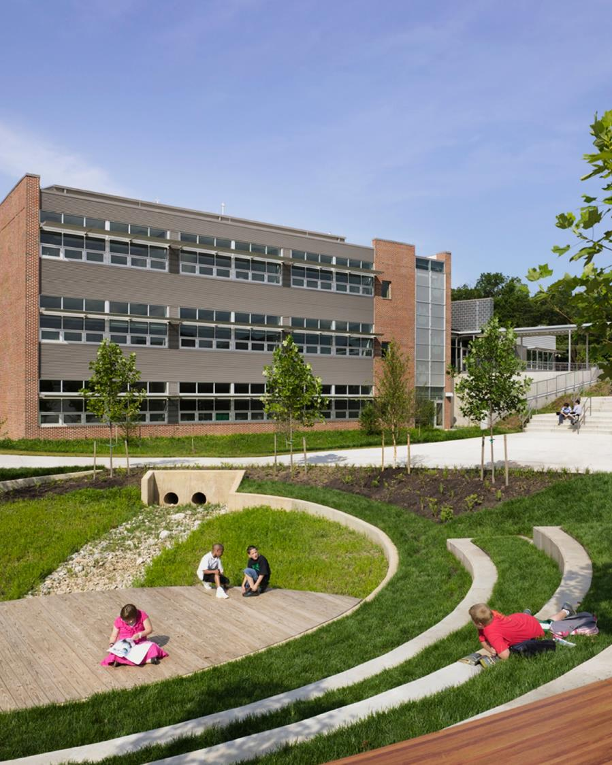
Places for people to work and study
like offices and schools
2017 ASLA Professional Honor Award, General Design
Facebook MBK20
San Francisco, CA
CMG Landscape Architecture
Image: Iwan Baan
2011 ASLA Professional Honor Award, General Design
Manassas Park Elementary School
Charlottesville, VA
Siteworks
Image: Siteworks

Slide 19
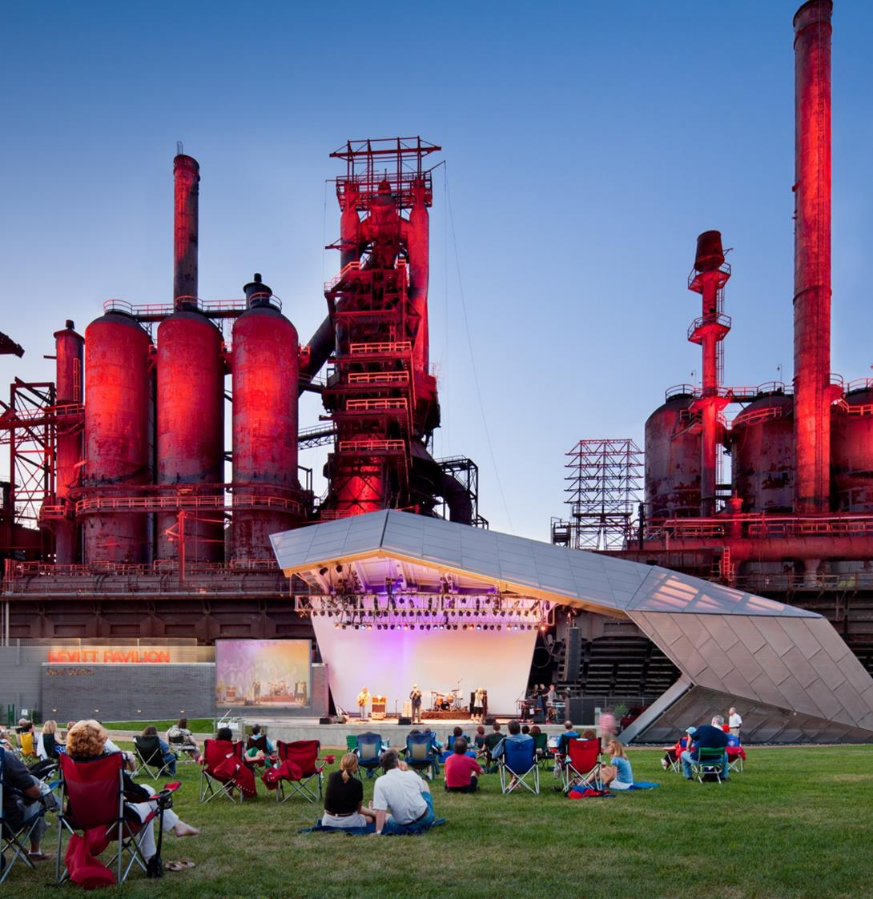
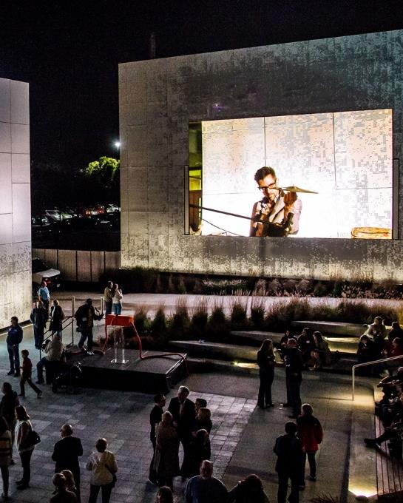
Places for people to gather and relax
like town squares and campuses
2017 ASLA Professional Honor Award, General Design
SteelStacks Art + Cultural Campus
Bethlehem, PA
WRT
Image: Paul Warchol
2015 ASLA Professional Honor Award, General Design
Public Media Commons
St. Lous, MO
DLAND Studio, Architecture + Landscape Architecture, PLLC
Image: Powers Bowersox Associates, DLANDstudio, Cobalt Office, and/or Nine Network / Jason Winkeler Photography

Slide 20
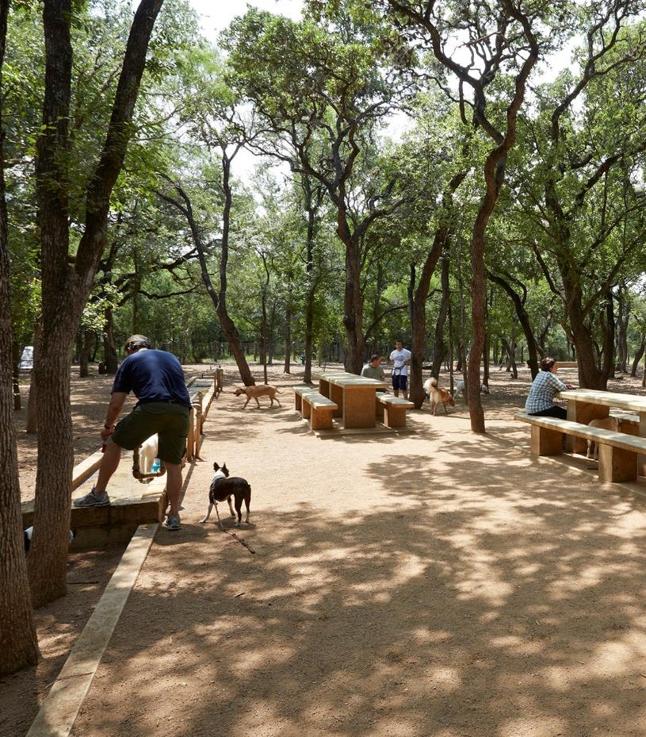
Places for people (and pets) to
exercise like parks and playgrounds
2015ASLA Professional Honor Award, General Design
Phil Hardberger Park
San Antonio, TX
Stephen Stimson Associates Landscape Architects
Image: Charles Mayer
2016 ASLA Professional Award of Excellence, General Design
Underpass Park
Toronto, ON, Canada
PFS Studio with The Planning Partnership
Image: Tom Arban

Slide 21
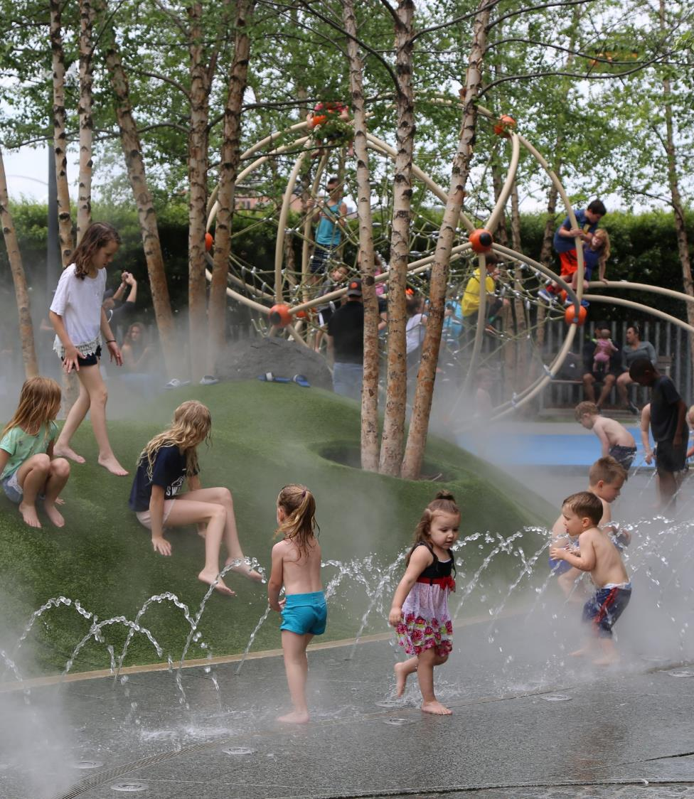
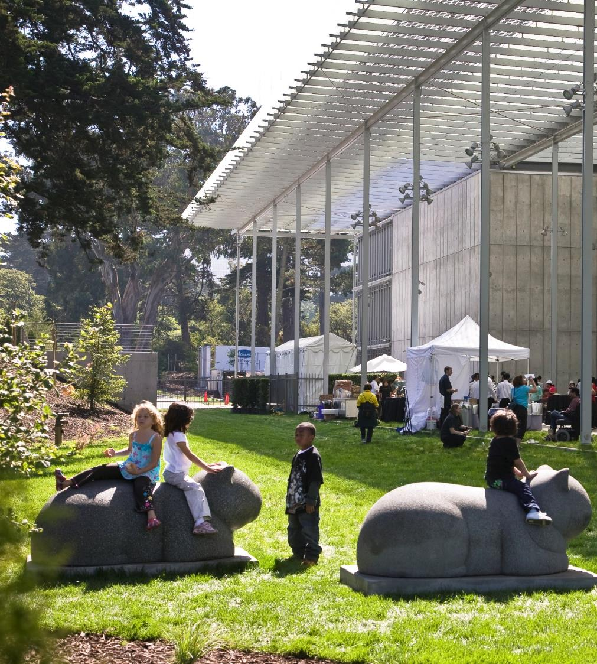
Places for people to have fun and learn like splash parks and museums
2017 ASLA Professional Award of Excellence, General Design
Klyde Warren Park
Dallas, TX
OJB Landscape Architecture
Image: Liane Rochelle Photography
2009 ASLA Professional Honor Award, General Design
California Academy of Sciences
San Francisco, CA
SWA Group
Image: Tom Fox

Slide 22
What do
LANDSCAPE
ARCHITECTS
do on a daily basis?

Slide 23
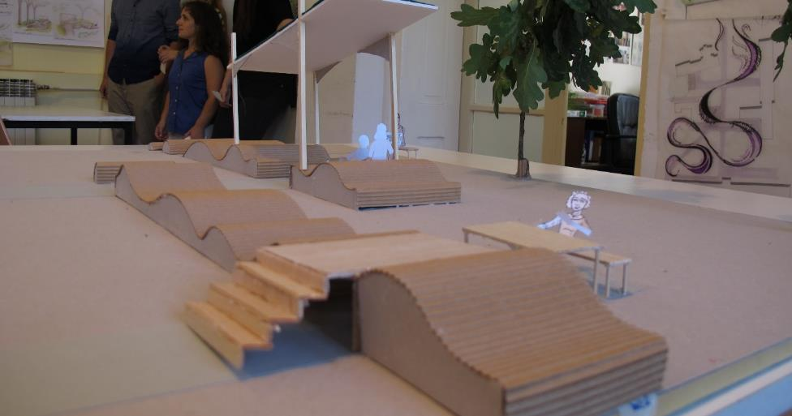
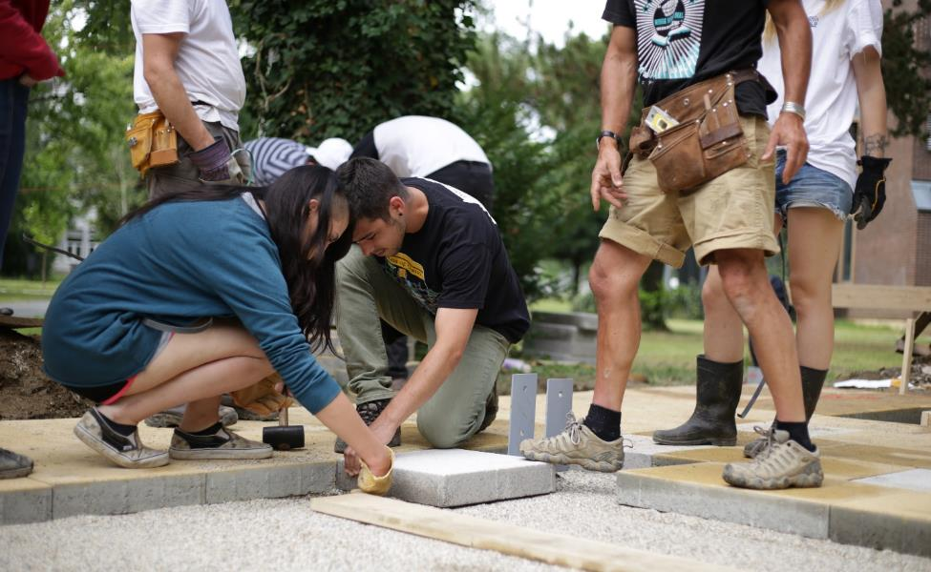
2016 ASLA Stidemt Honor Award, Student Collaboration
Bridging Disciplines/Cultivating Health
Seattle, WA
University of Washington
Image: Daniel Winterbottom, FASLA
Work with architects, engineers, planners, developers, and more
Solve problems, build models, and create design solutions for clients
Meet with clients and communities to talk about design and construction

Slide 24
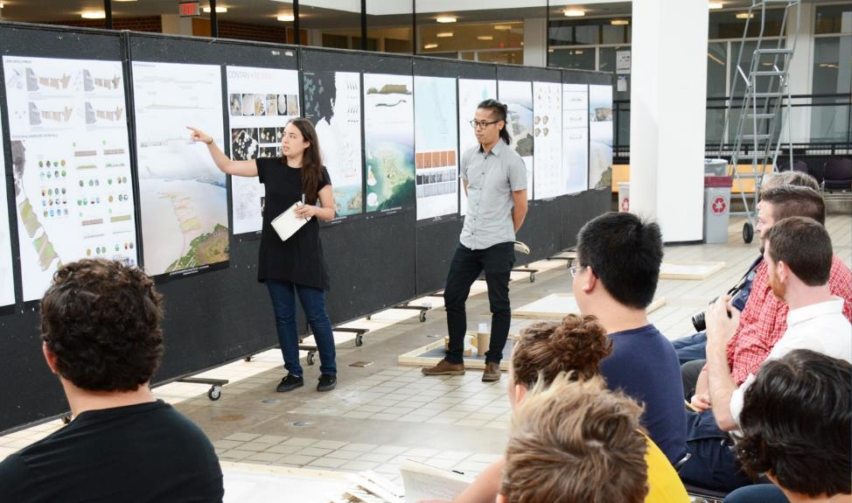
Attend meetings to make presentations of design solutions
Work with computers and technology to create drawings and solutions
Visit projects under construction
2016 ASLA Professional Honor Award, Communications
DredgeFest Event Series
The Dredge Research Collaborative
Image: The Dredge Research Collaborative
2016 ASLA Stidemt Honor Award, Student Collaboration
The Vietnam Veterans Memorial
Ball State University
Image: images@asla.org

Slide 25
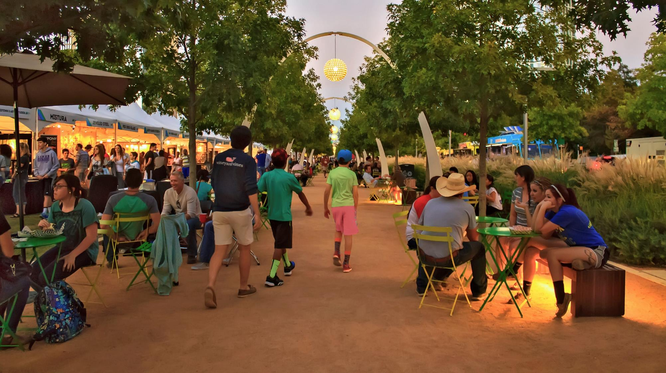
COULD YOU BECOME A
LANDSCAPE ARCHITECT?
2017 ASLA Professional Award of Excellence, General Design
Klyde Warren Park
Dallas, TX
OJB Landscape Architecture
Image: Liane Rochelle Photography

Slide 26
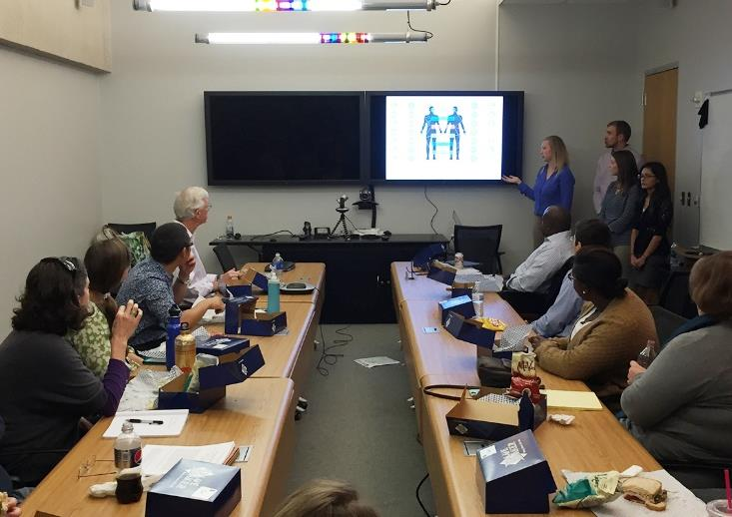
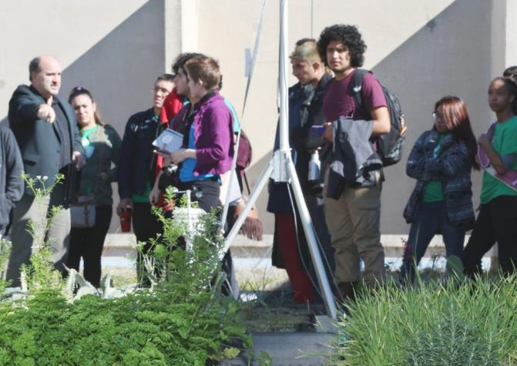
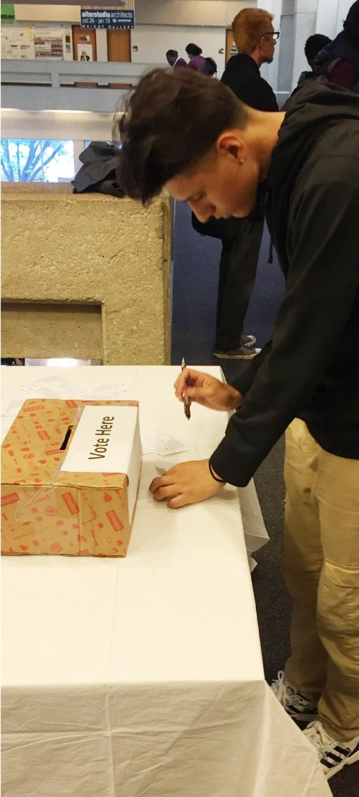
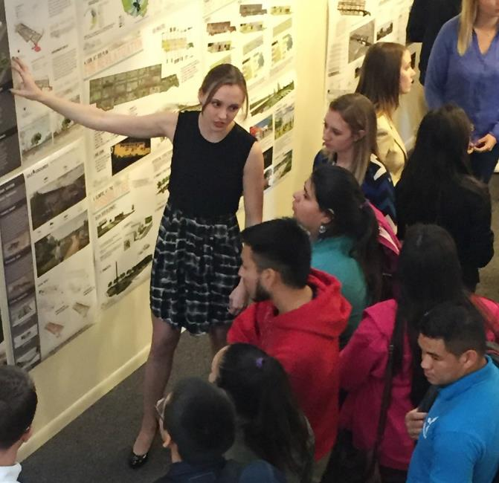
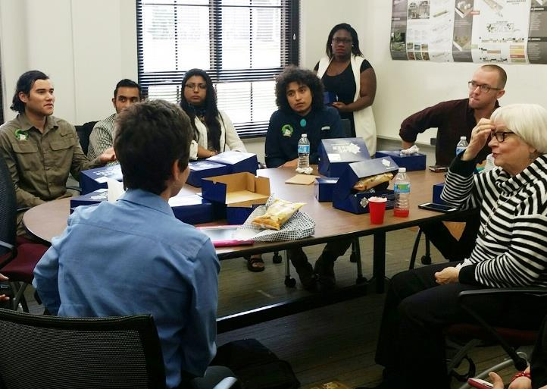
STUDY LANDSCAPE ARCHITECTURE!
2016 ASLA Student Honor Award, Community Service
Neighborhood Detox
College Station, TX
Texas A&M University
Image: Texas A&M University

Slide 27
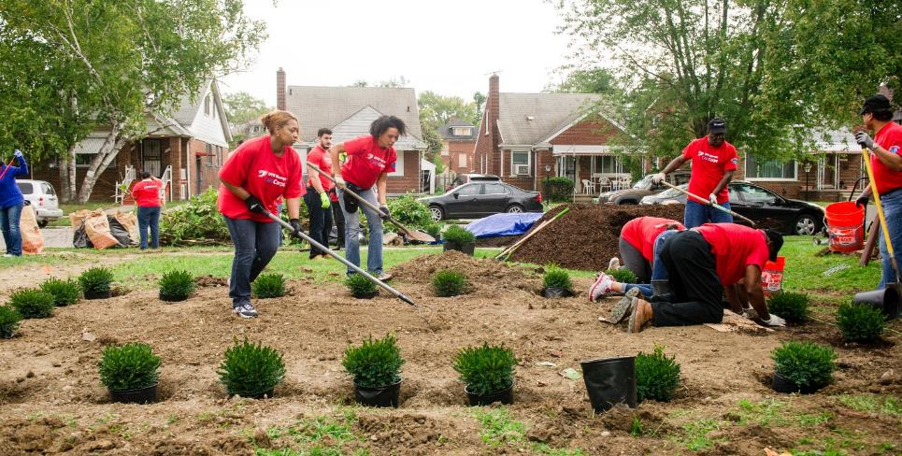
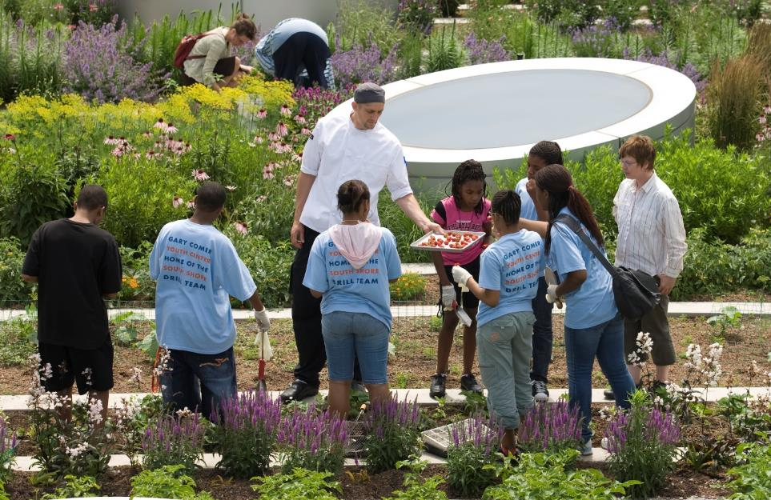
LEARN MORE BY:
Visiting a landscape architect’s office
Volunteering at local environmental volunteer program
Having a conversation about the built environment; ask your parents, relatives, and friends about design
2016 ASLA Professional Honor Award, Communications
Activating Land Stewardship and Participation in Detroit
Detroit, MI
Detroit Future City
Image: Andrew Potter
2016 ASLA Professional Honor Award, General Design
Rooftop Haven for Urban Agriculture
Chicago, IL
Hoerr Schaudt Landscape Architects
Image: Scott Shigley

Slide 28
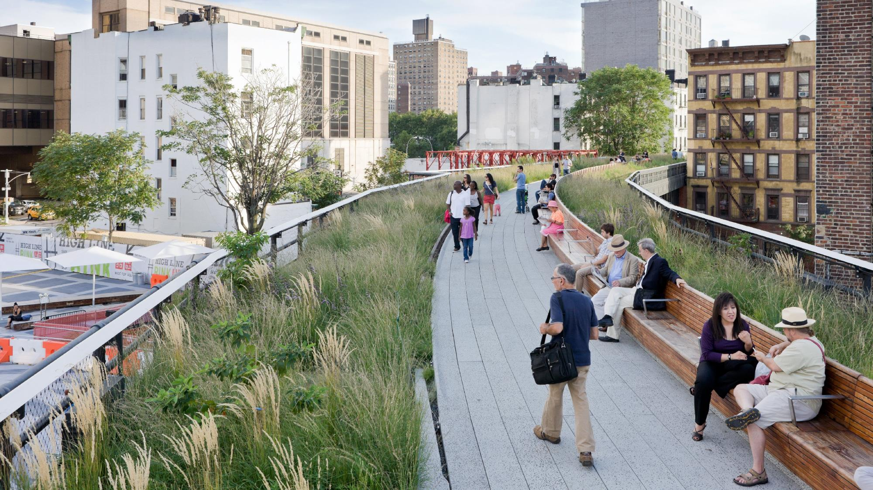
2013 ASLA Professional Honor Award, General Design
High Line, Section 2
New York, NY
James Corner Field Operations
Image: Iwan Baan
THANK YOU!
Discover more at:
asla.org/yourpath

